Slide 1
We honor Rabbi Stephen Einstein

Slide 2
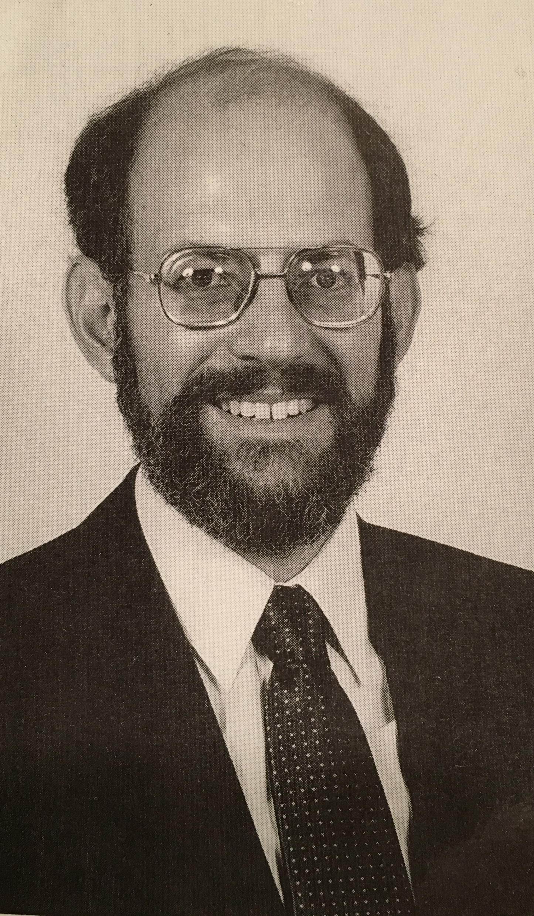
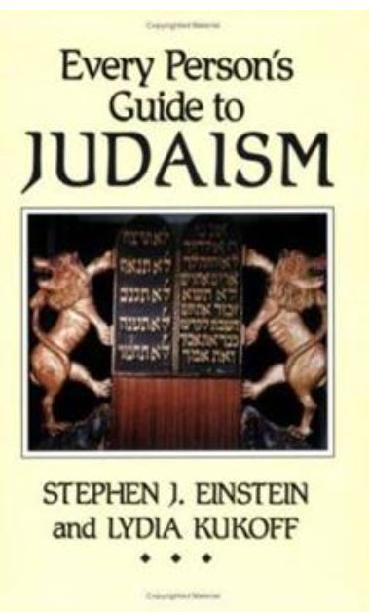
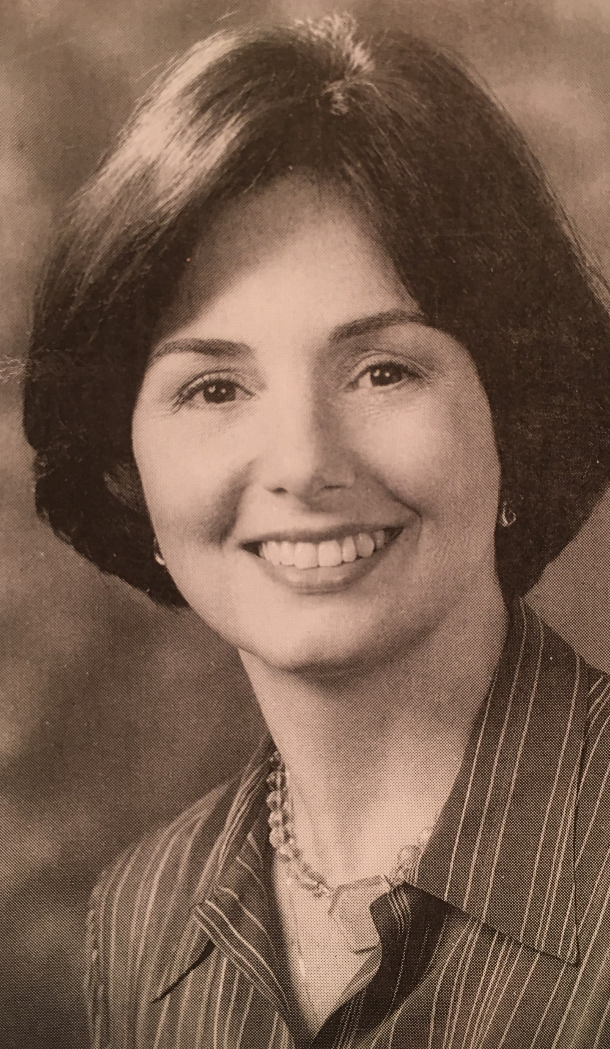

Slide 3
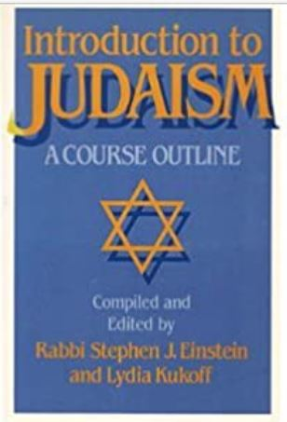
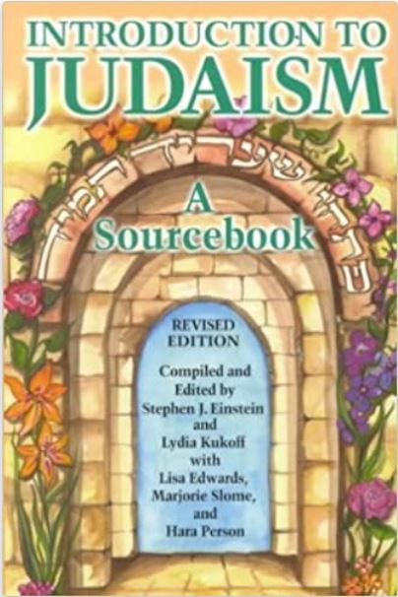
I count it a great z’chut to be among those who warmly welcome all who seek a home within this People Israel.
Rabbi Stephen Einstein

Slide 4
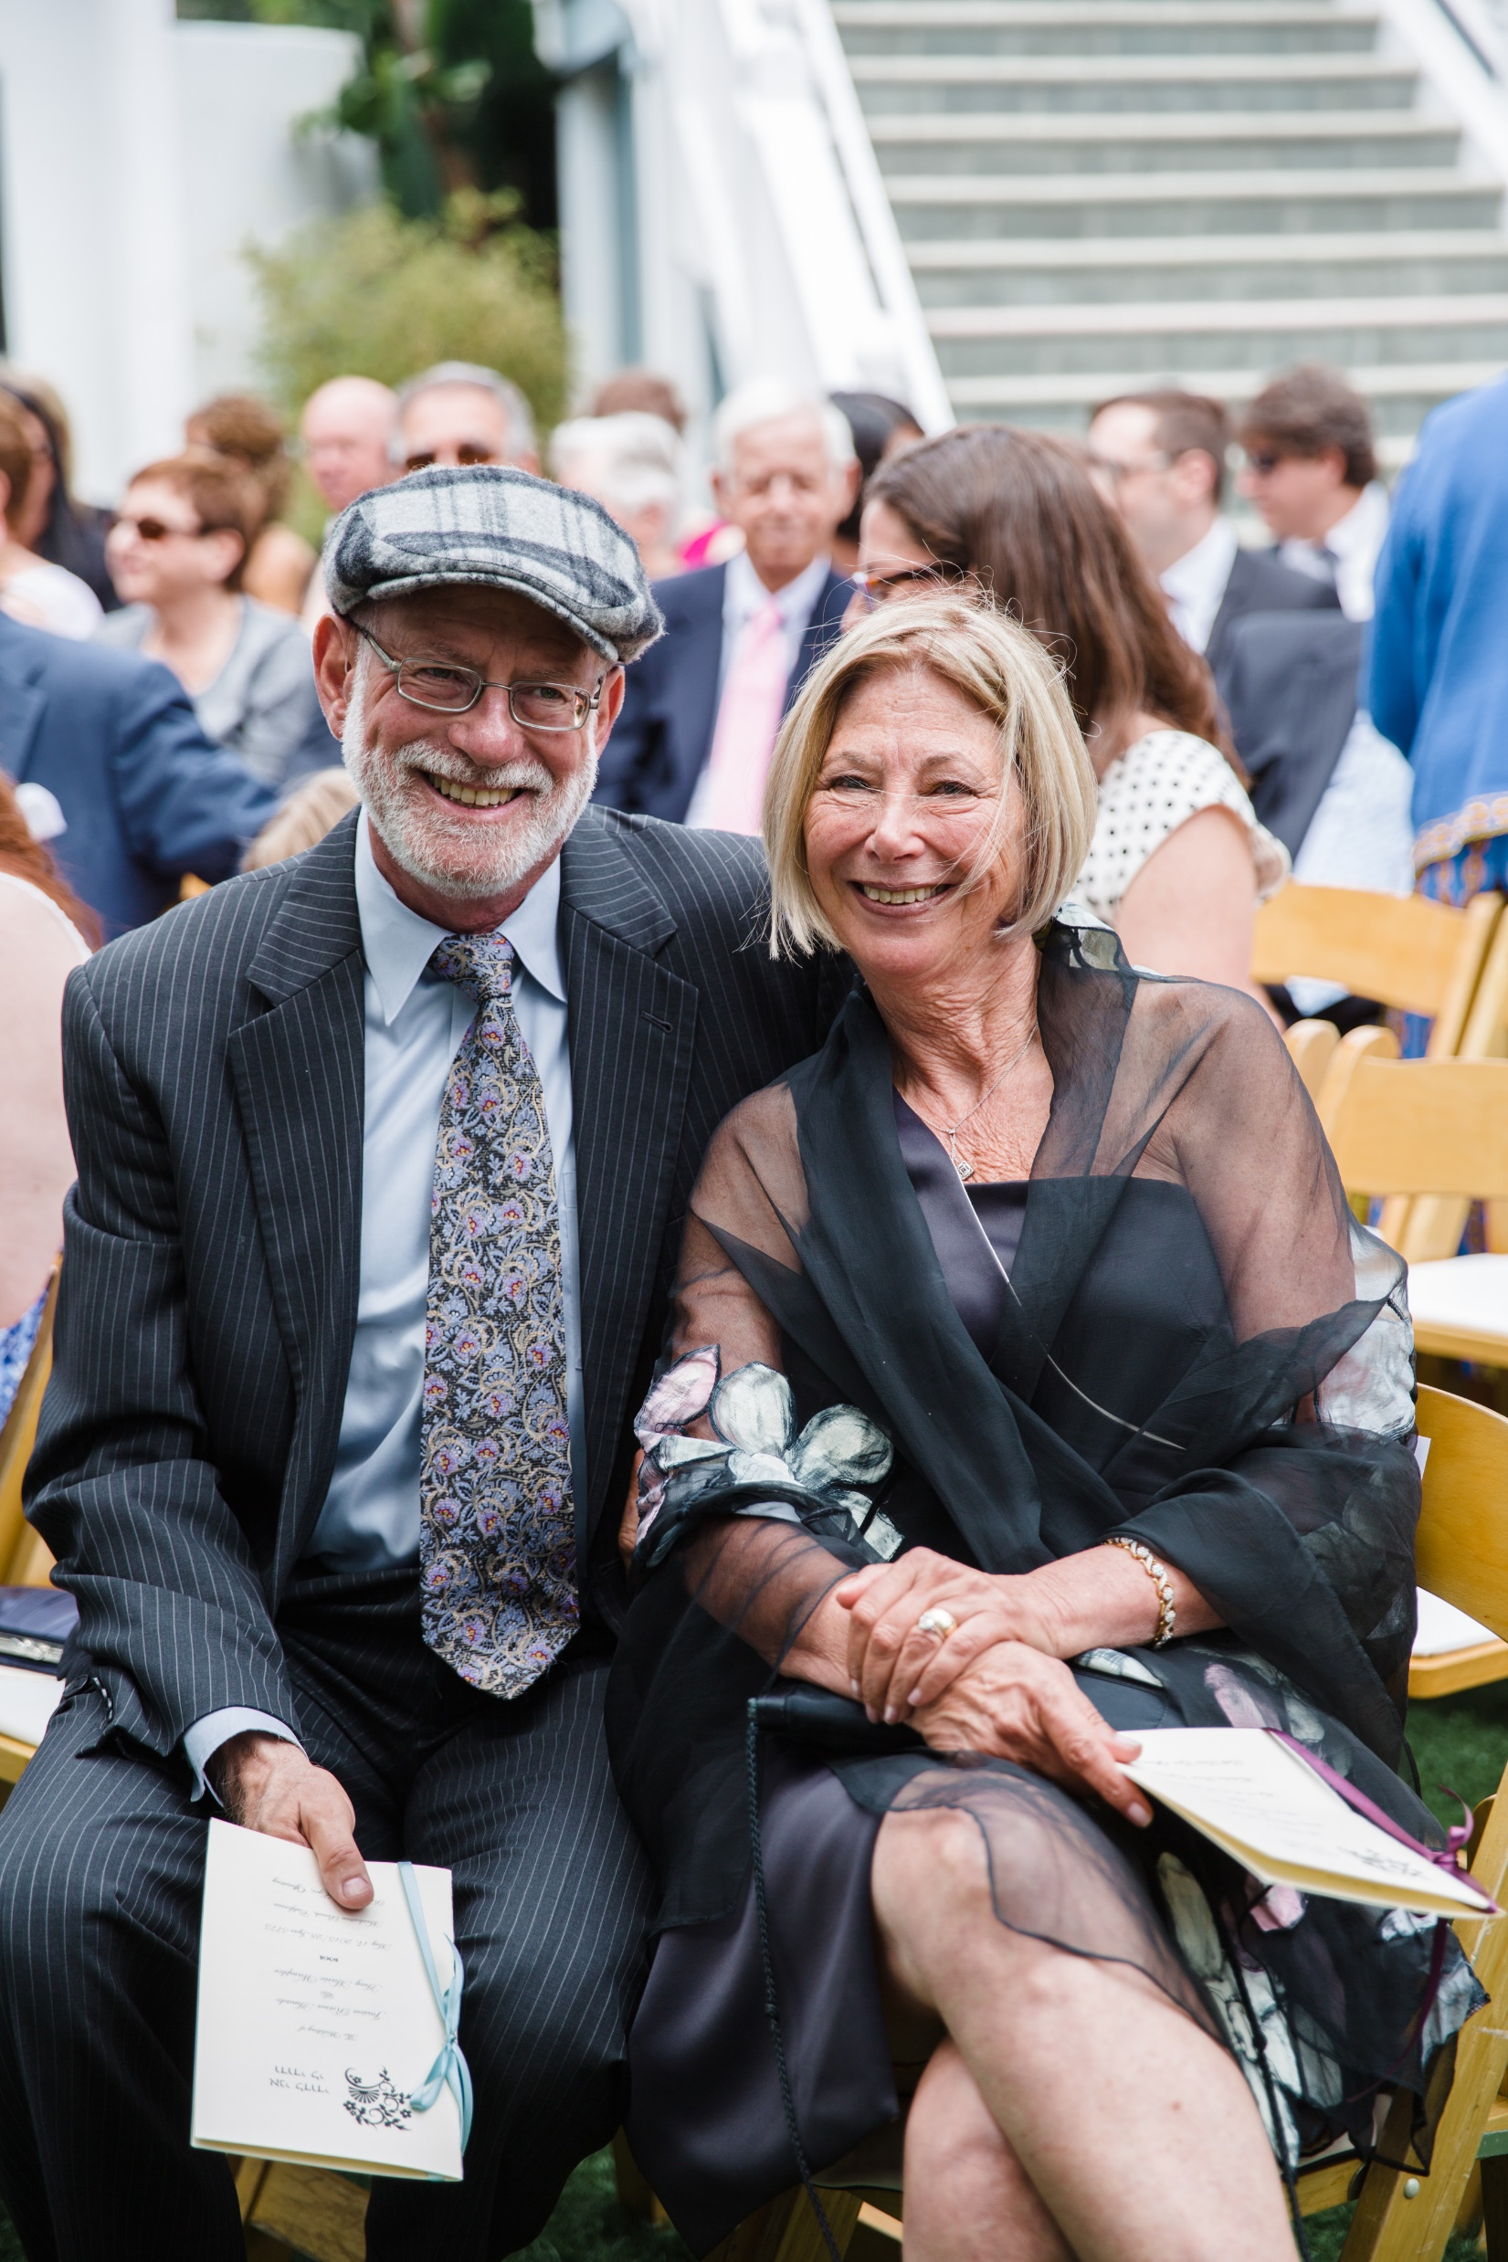
The honor bestowed upon me today surely can be shared with all my colleagues engaged in this sacred work.
Rabbi Stephen Einstein

Slide 5
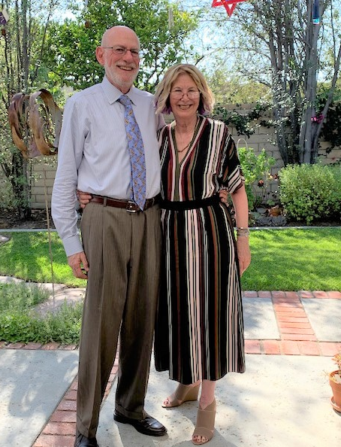
“It’s not so much that I embraced Judaism,
but Judaism embraced ME!”
Rabbi Stephen Einstein

Slide 6
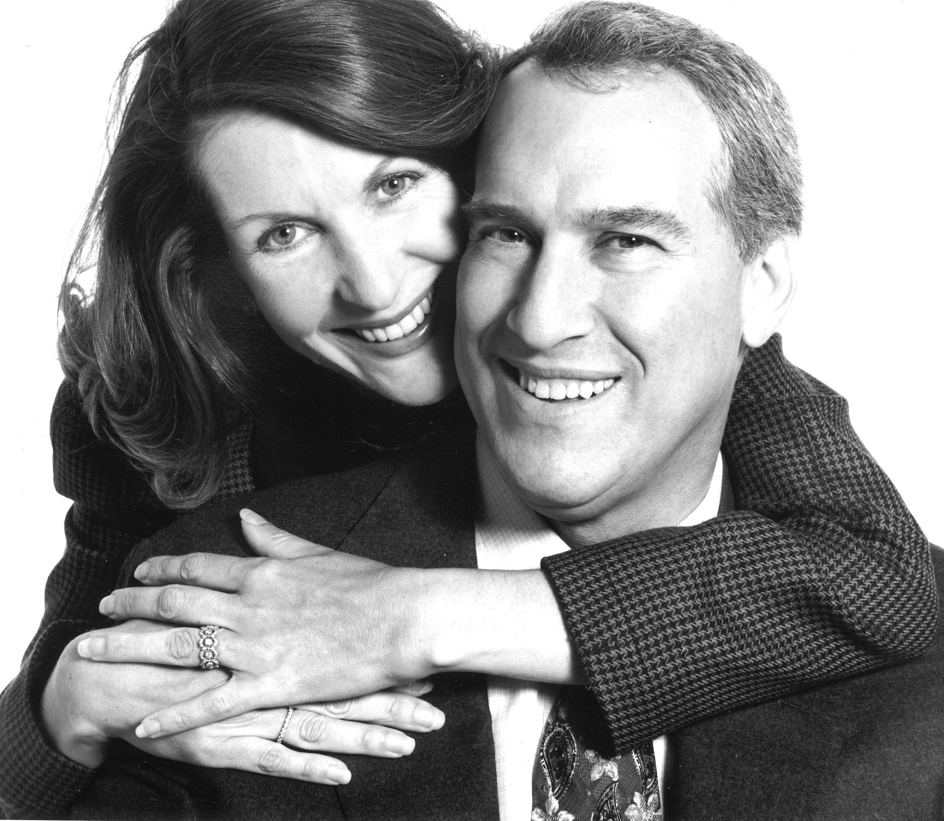
Sandra Caplan z”l,
a Jew-by-choice,
fully embraced Judaism
in her life.
The George Caplan Family

Slide 7
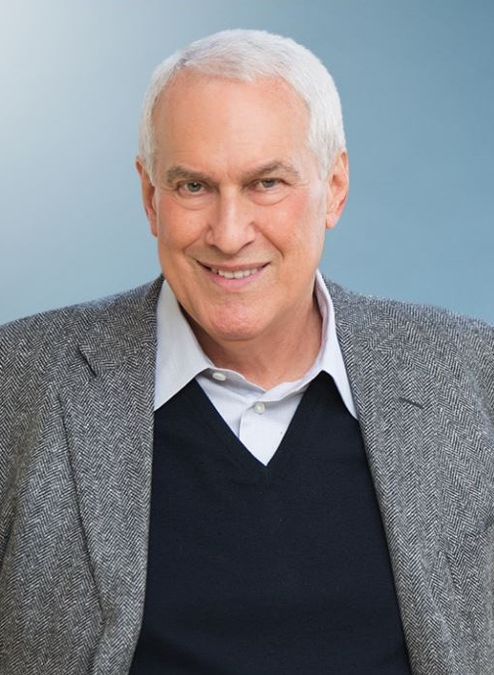
In loving memory of his wife, George Caplan funded our pluralistic community bet din, named in Sandra’s honor.
The George Caplan Family

Slide 8
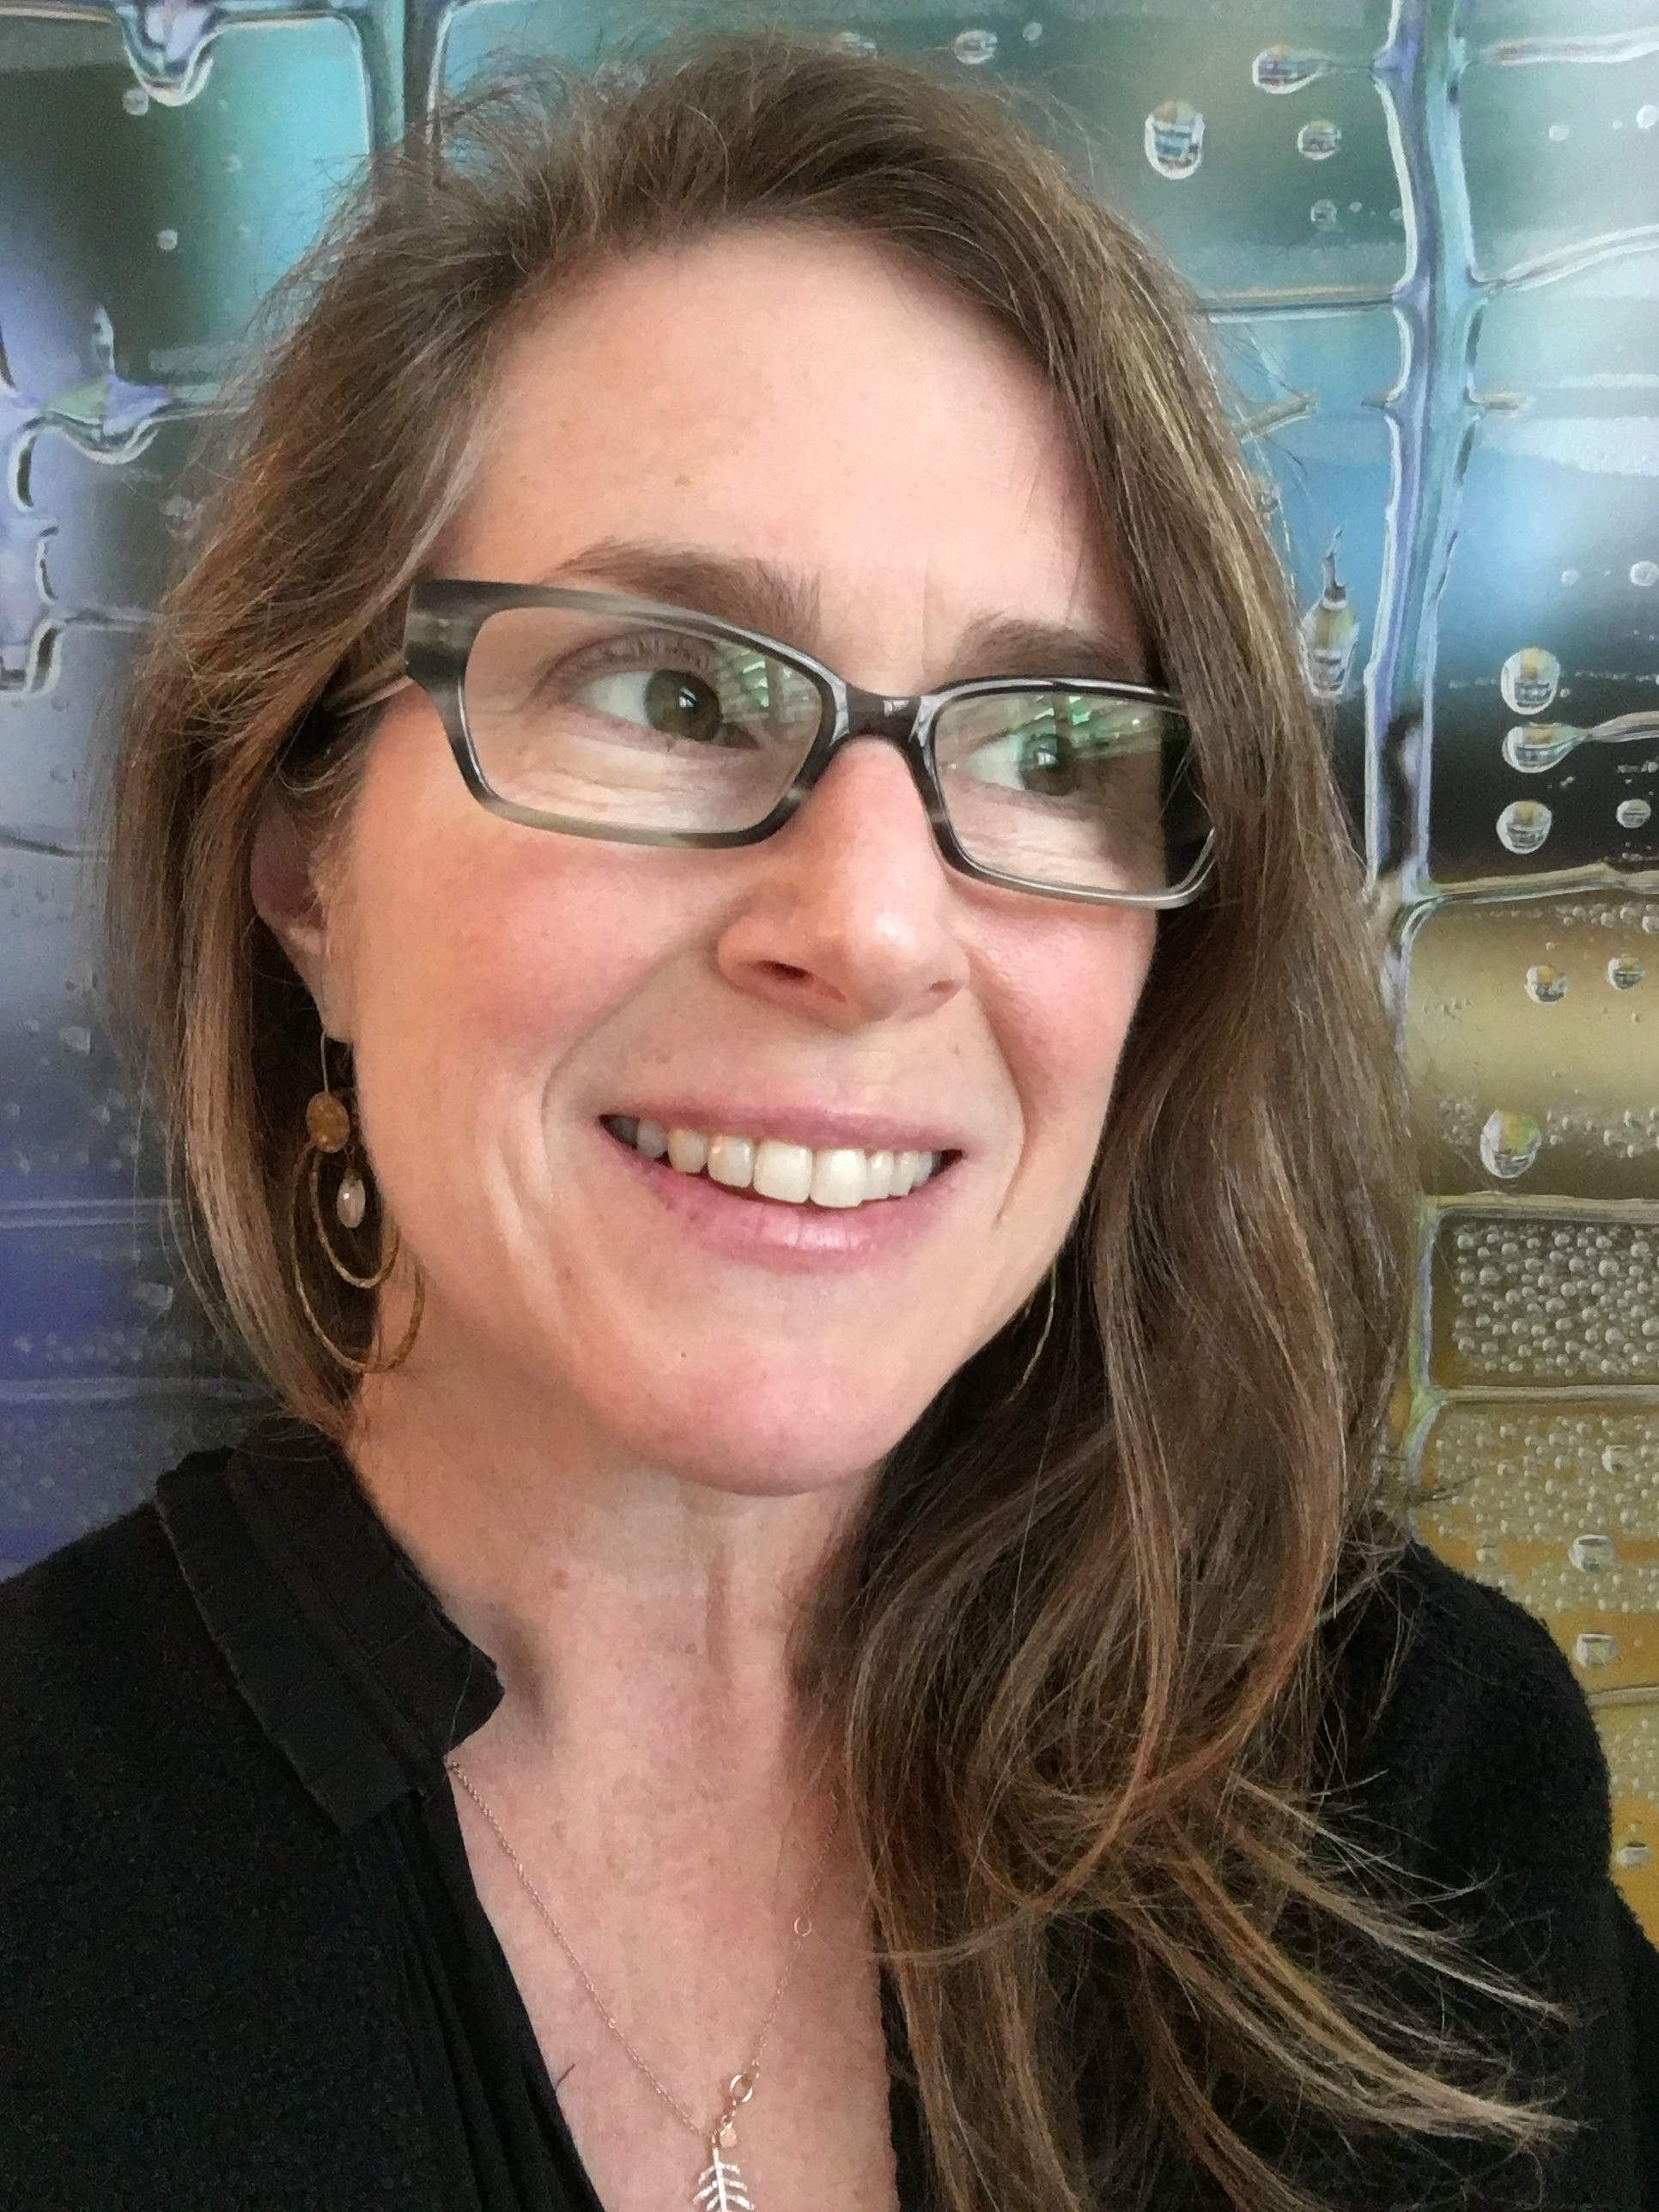
“Rabbi Steve shares
the Caplan family’s commitment to tzedakah and hospitality.”
Elana Caplan Jassy

Slide 9
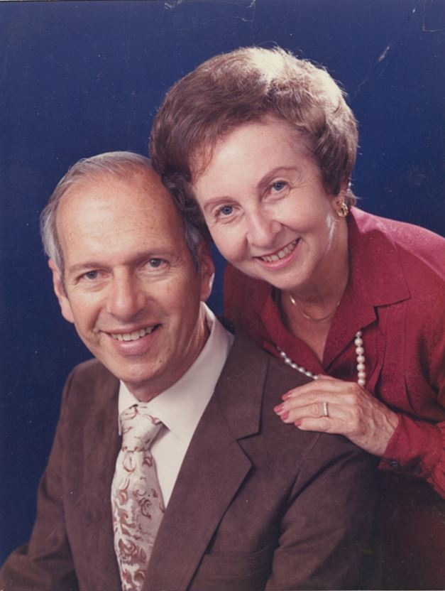
Abe & Edith Ballonoff Family Foundation
congratulates
Rabbi Stephen Einstein
on his five decades of devotion to welcoming
Jews-by-Choice into our community.
Lynn Beliak

Slide 10
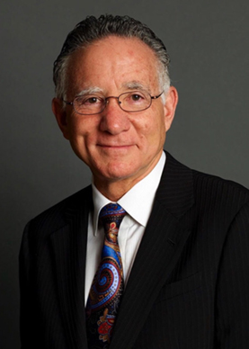
“Do not merely believe that life is worthwhile – make it worthwhile.” Mordecai M. Kaplan
You are a shining example to everyone that what we say matters, what we do matters, and who we are matters.
Rabbi Steven Carr Reuben

Slide 11
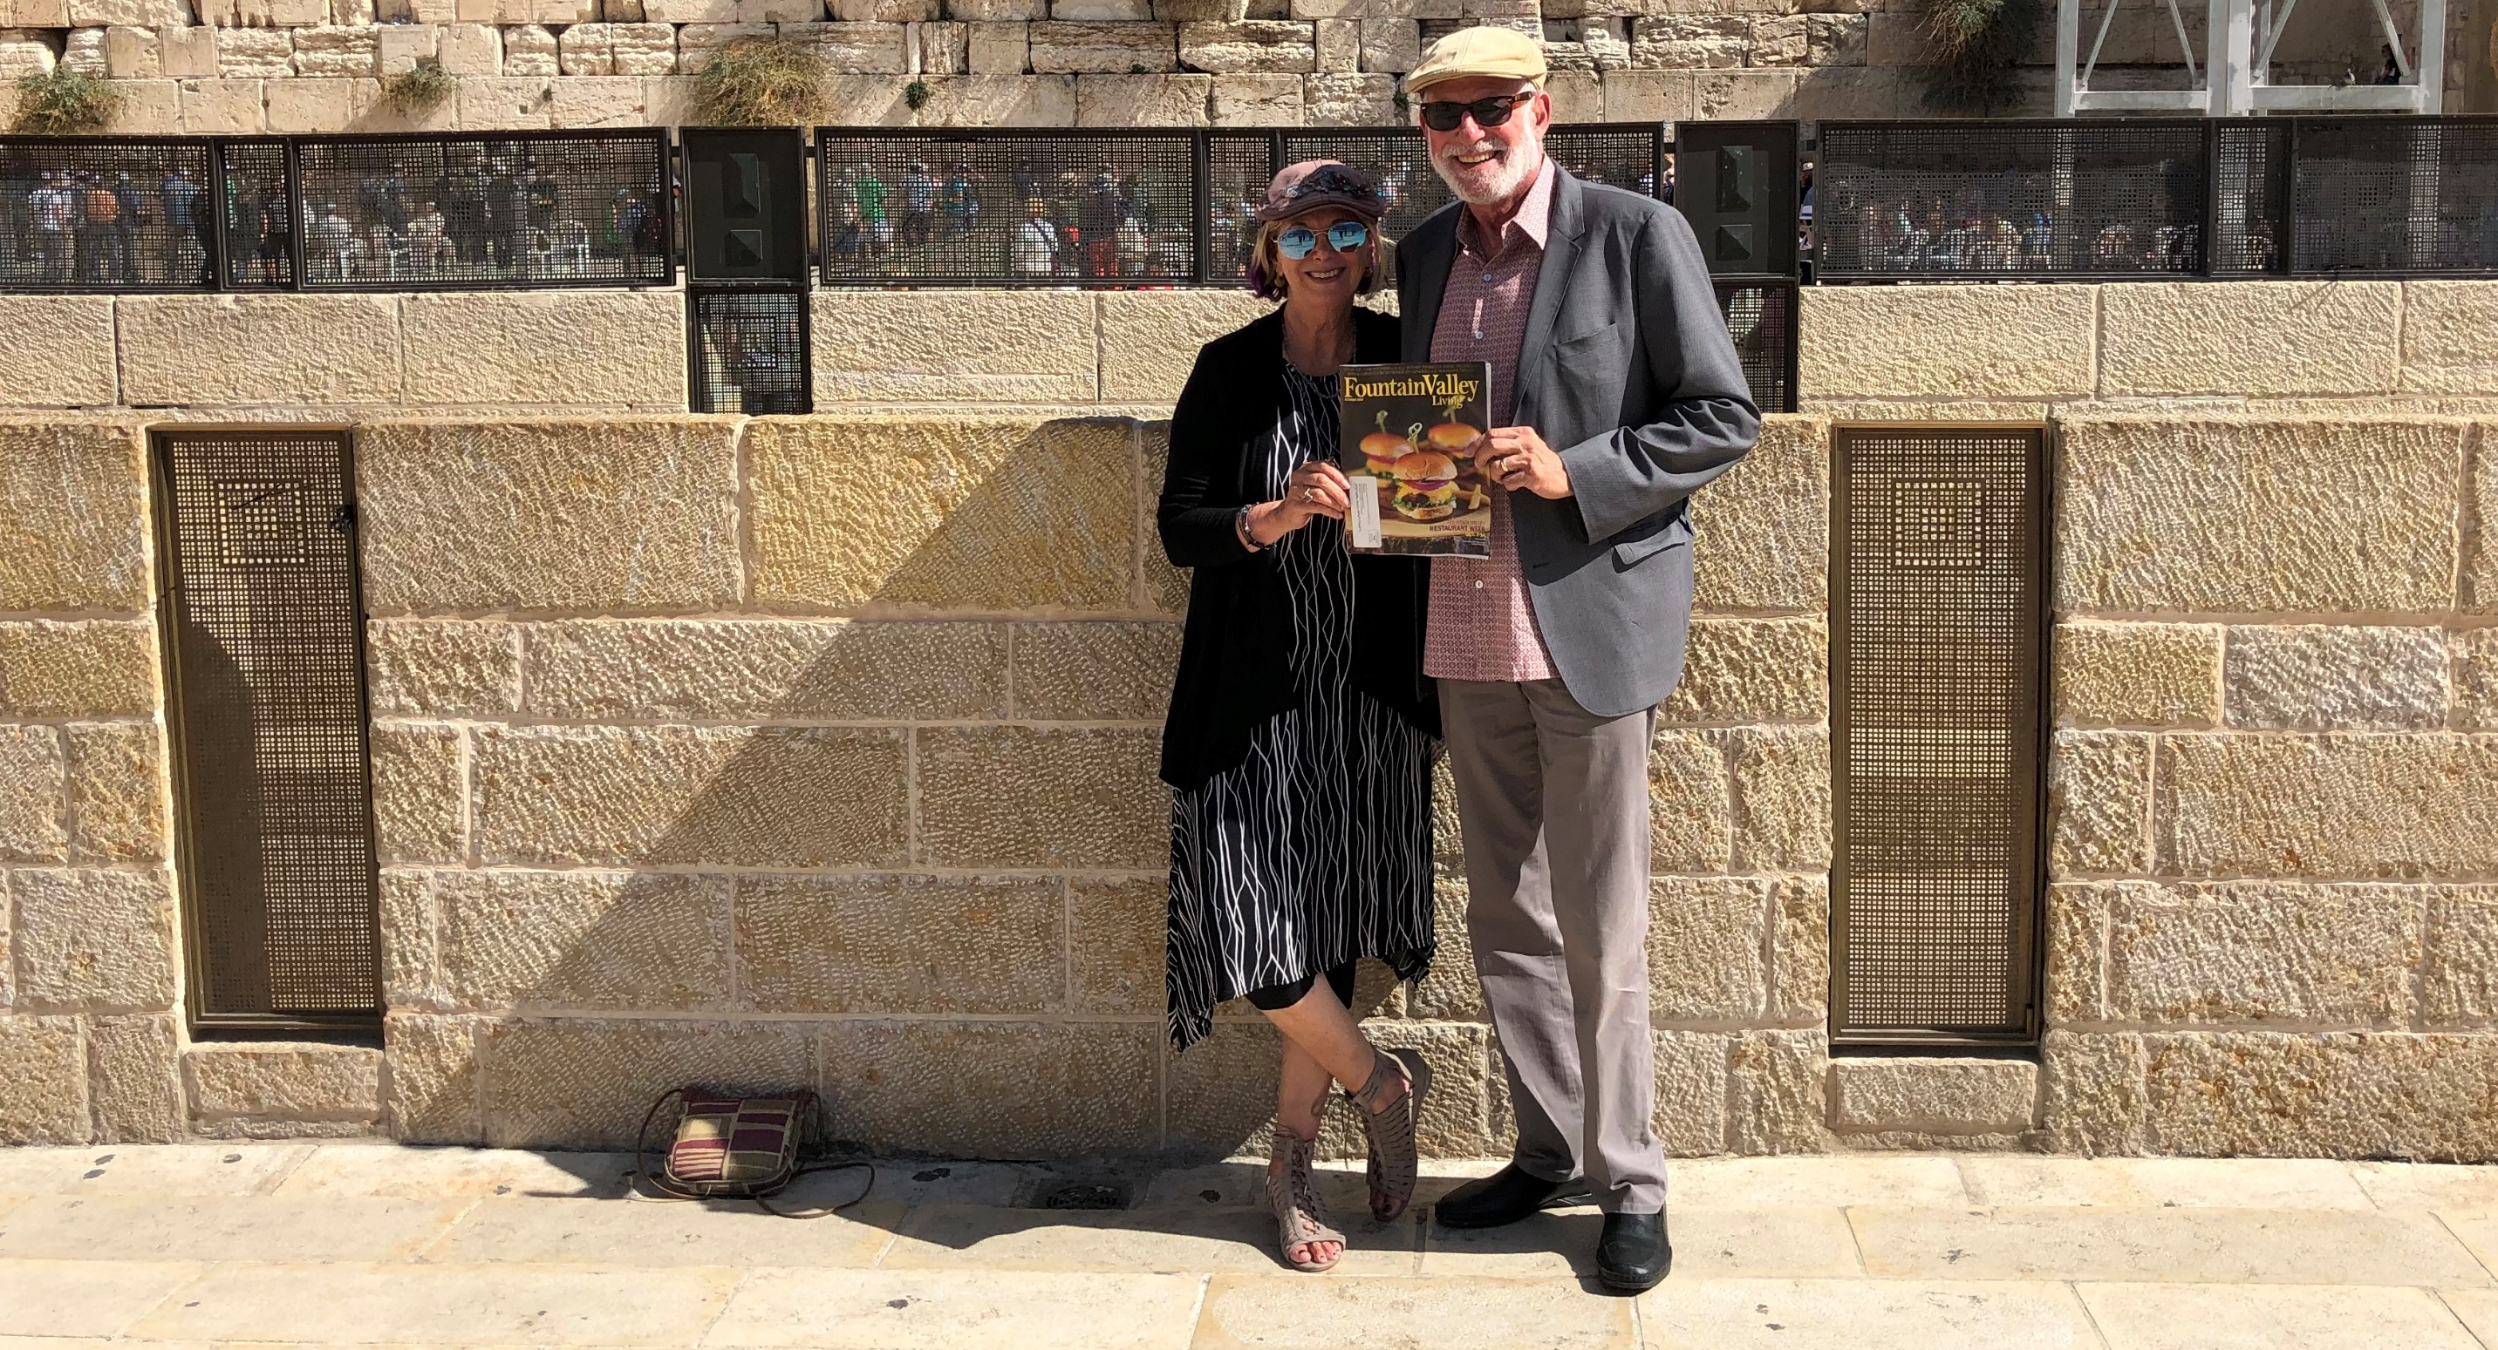
Rabbi Steve
Thank you for sharing our Jewish traditions and teachings so others can enjoy the beauty of Judaism.
You are a true mensch!
Nancy & Irv Chase

Slide 12
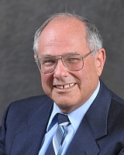
Thank you, Rabbi Einstein, for 50 years of welcoming people into the Jewish fold.
Your warmth, intelligence, and deep Jewish commitments make you a wonderful model of what it means to be a Jew. Thank you even more for being you!
With appreciation & love, Marlynn and Rabbi Elliot Dorff

Slide 13
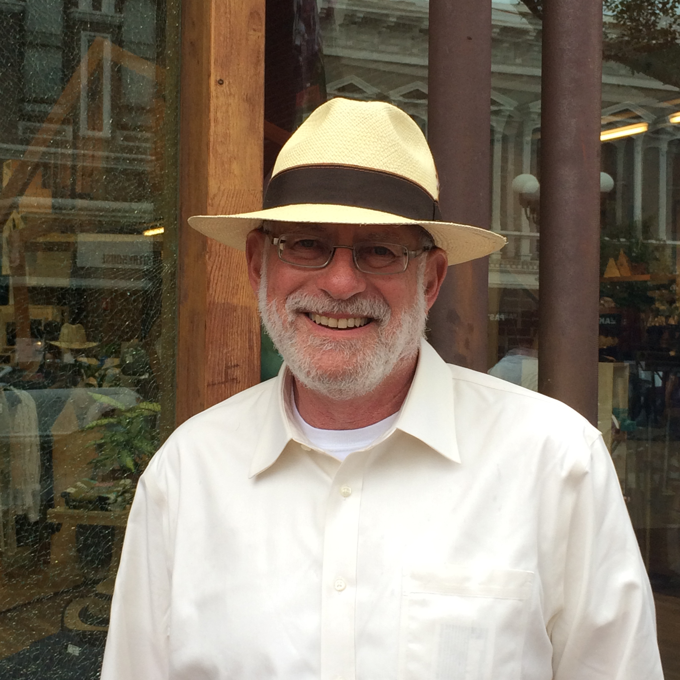
Congratulations, Rabbi Steve!
Your leadership and dedication to Jewish outreach has touched and inspired so many.
With gratitude and joy,
The Bock Family - Ken & Rabbi Lisa

Slide 14
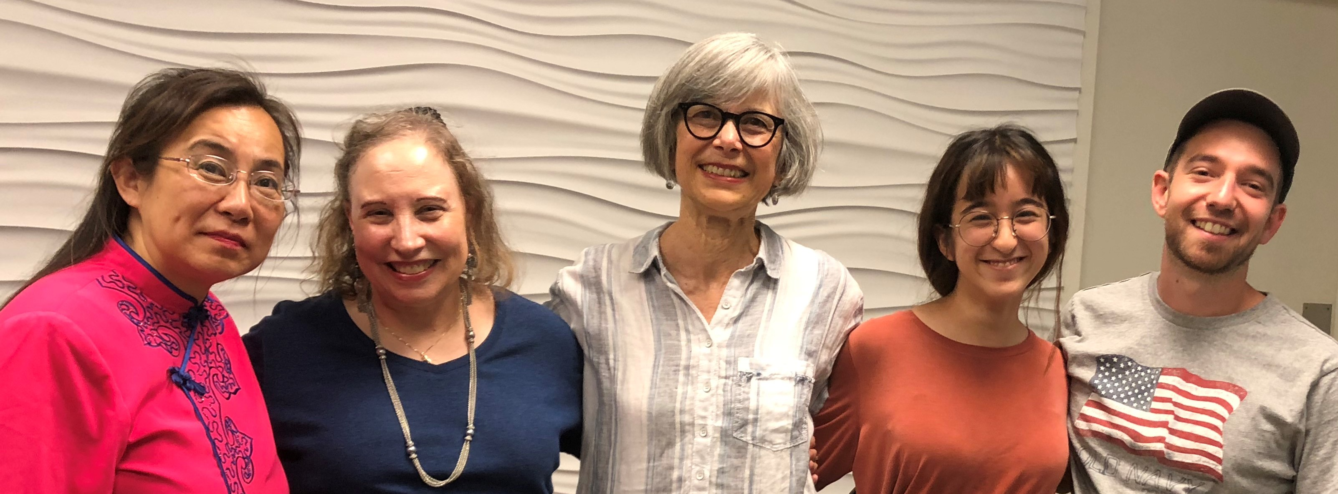
May the Sandra Caplan Community Bet Din continue to embody Rabbi Steve’s welcoming embrace.
Muriel Dance

Slide 15
Steve,
My life has been enriched by collaborating with you to change the landscape in congregations.
Arlene Chernow

Slide 16
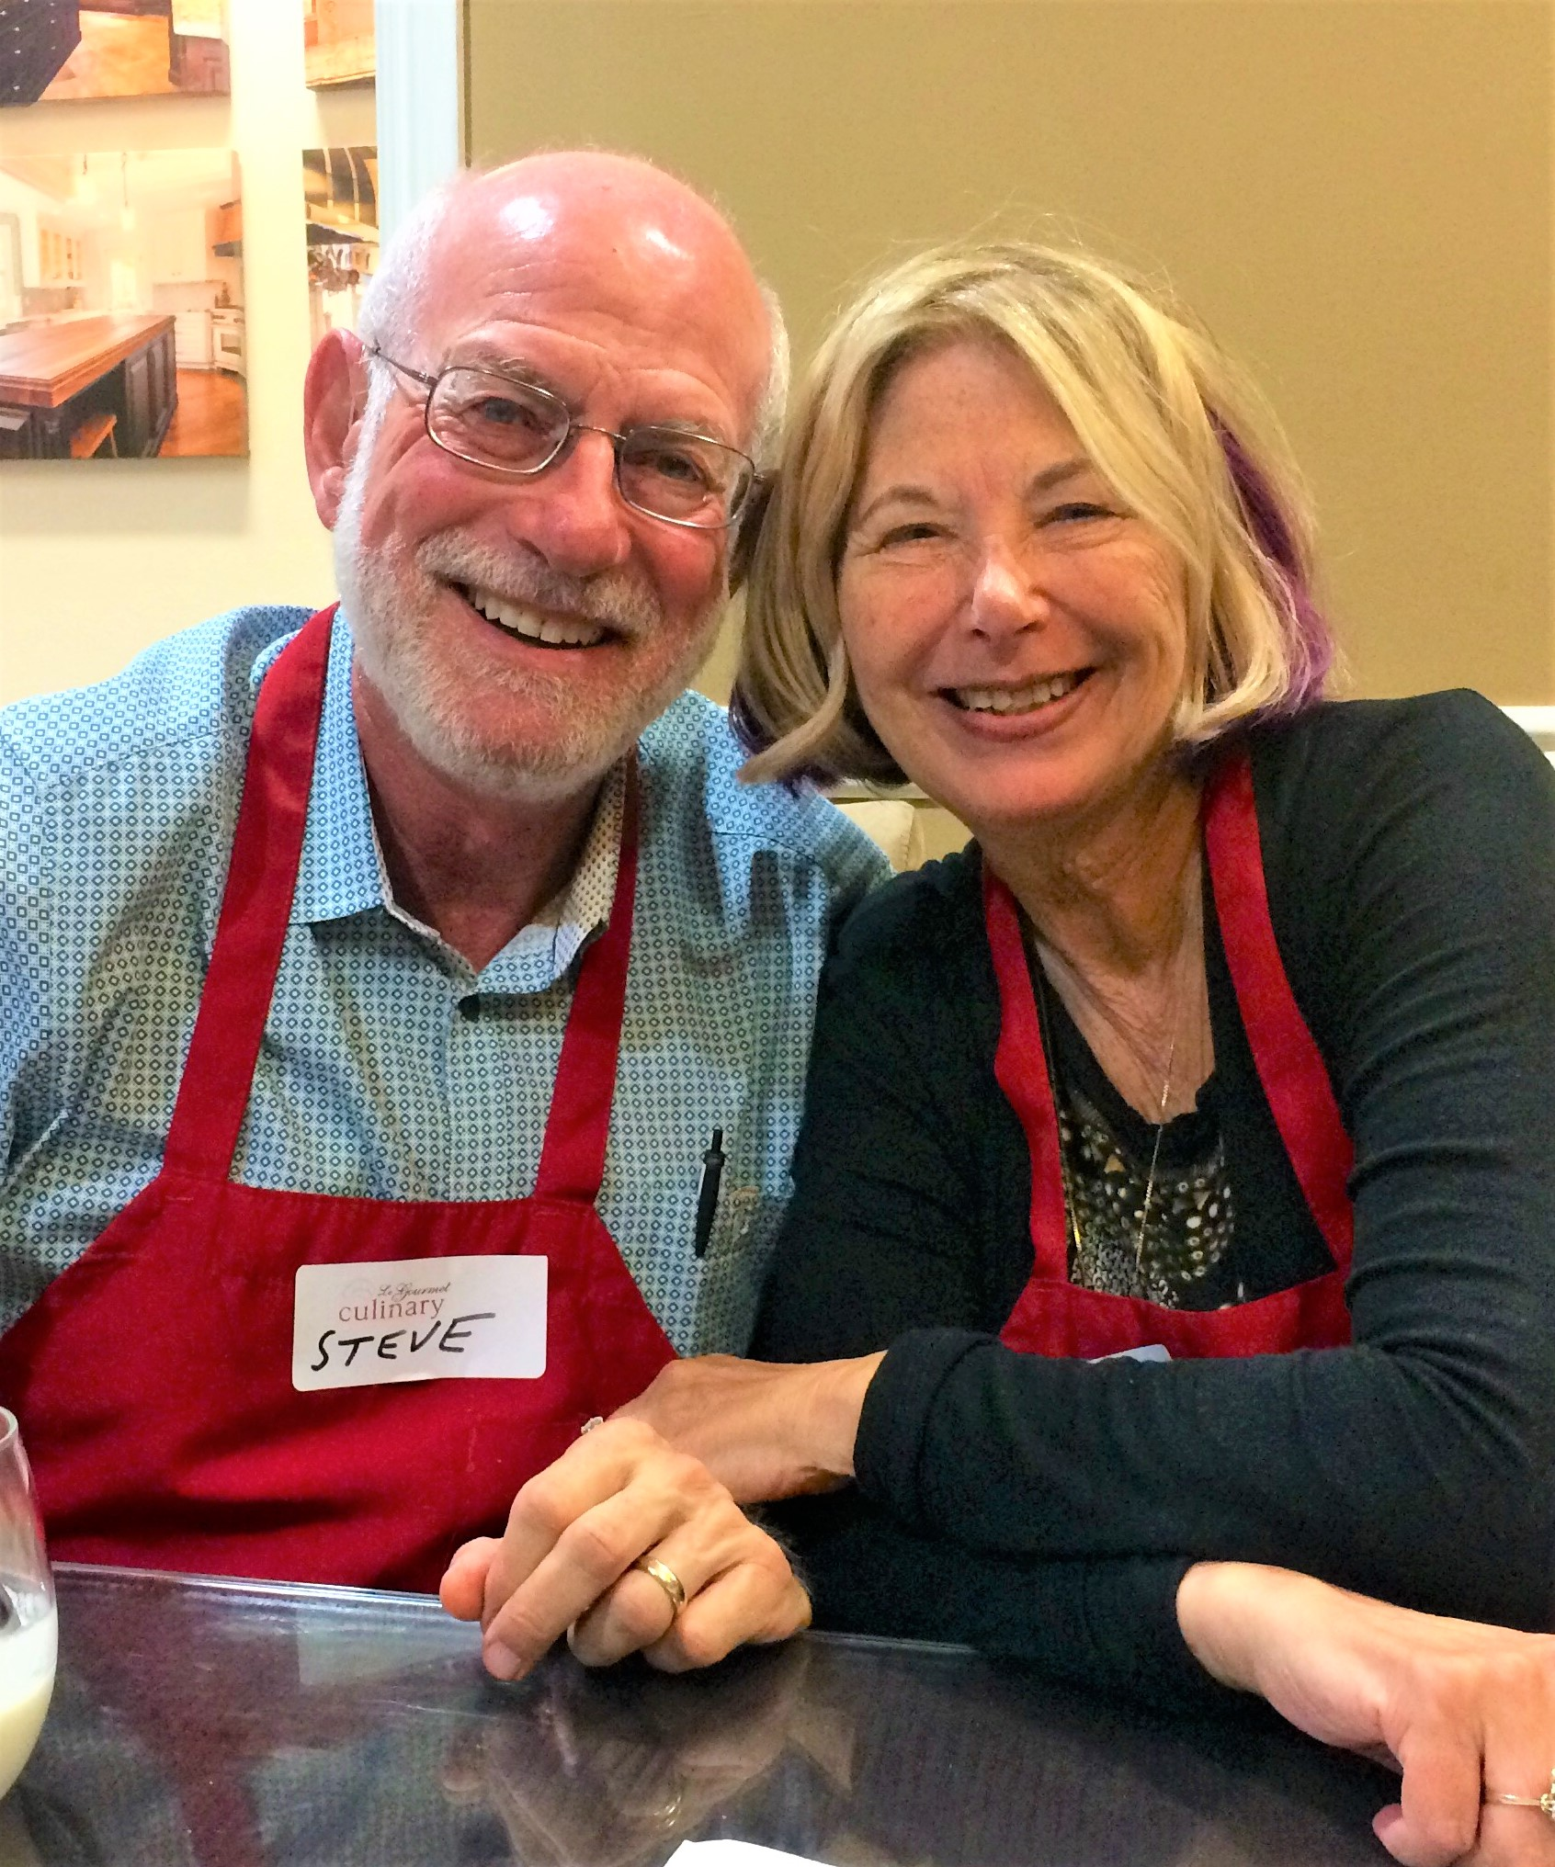
Steve & Robin
I have been blessed to share my life with you.
With love & admiration,
Lynda Einstein

Slide 17
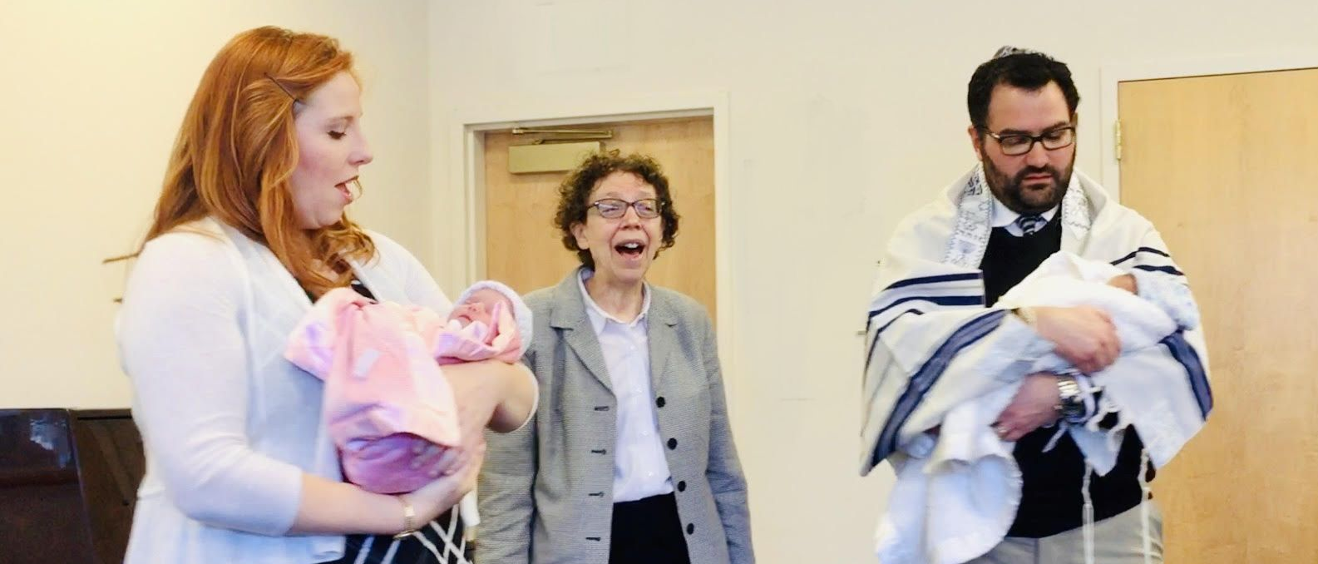
Melanie Aron, Rabbi Emerita
Congregation Shir Hadash, Los Gatos
Thank you to OUR Rabbi Einstein! with love, The Roman Family

Slide 18
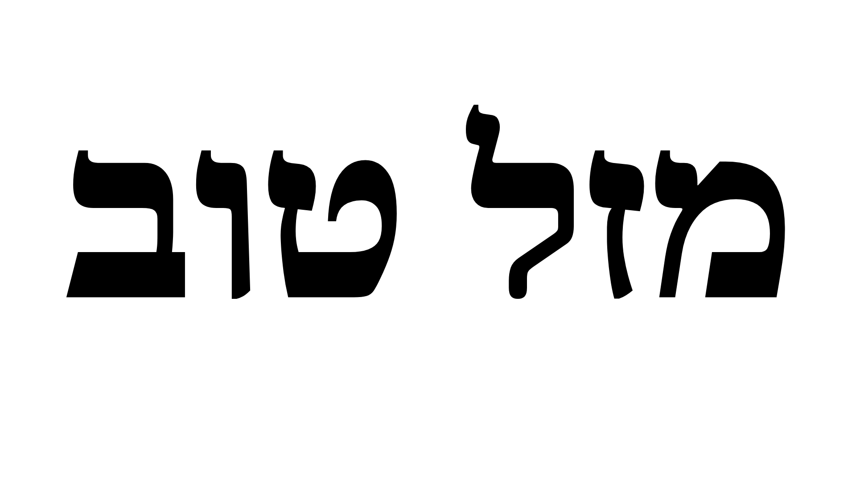
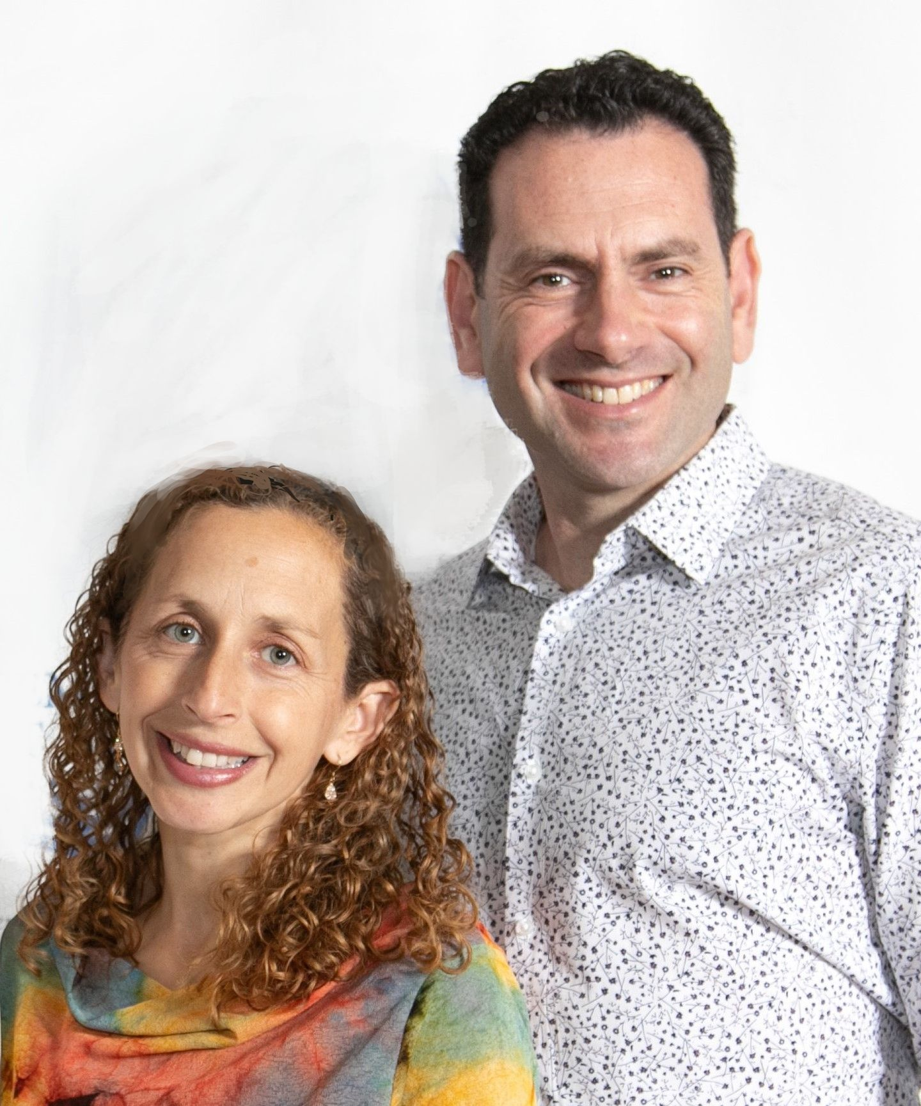
With admiration and appreciation for your dedication to the
Orange County Jewish community, and beyond.
Rabbis Gersh Zylberman and Rayna Gevurtz

Slide 19
on this great honor,
Rabbi Steve!
Vicky Farhi, Dru Greenwood & Kathy Kahn

Slide 20
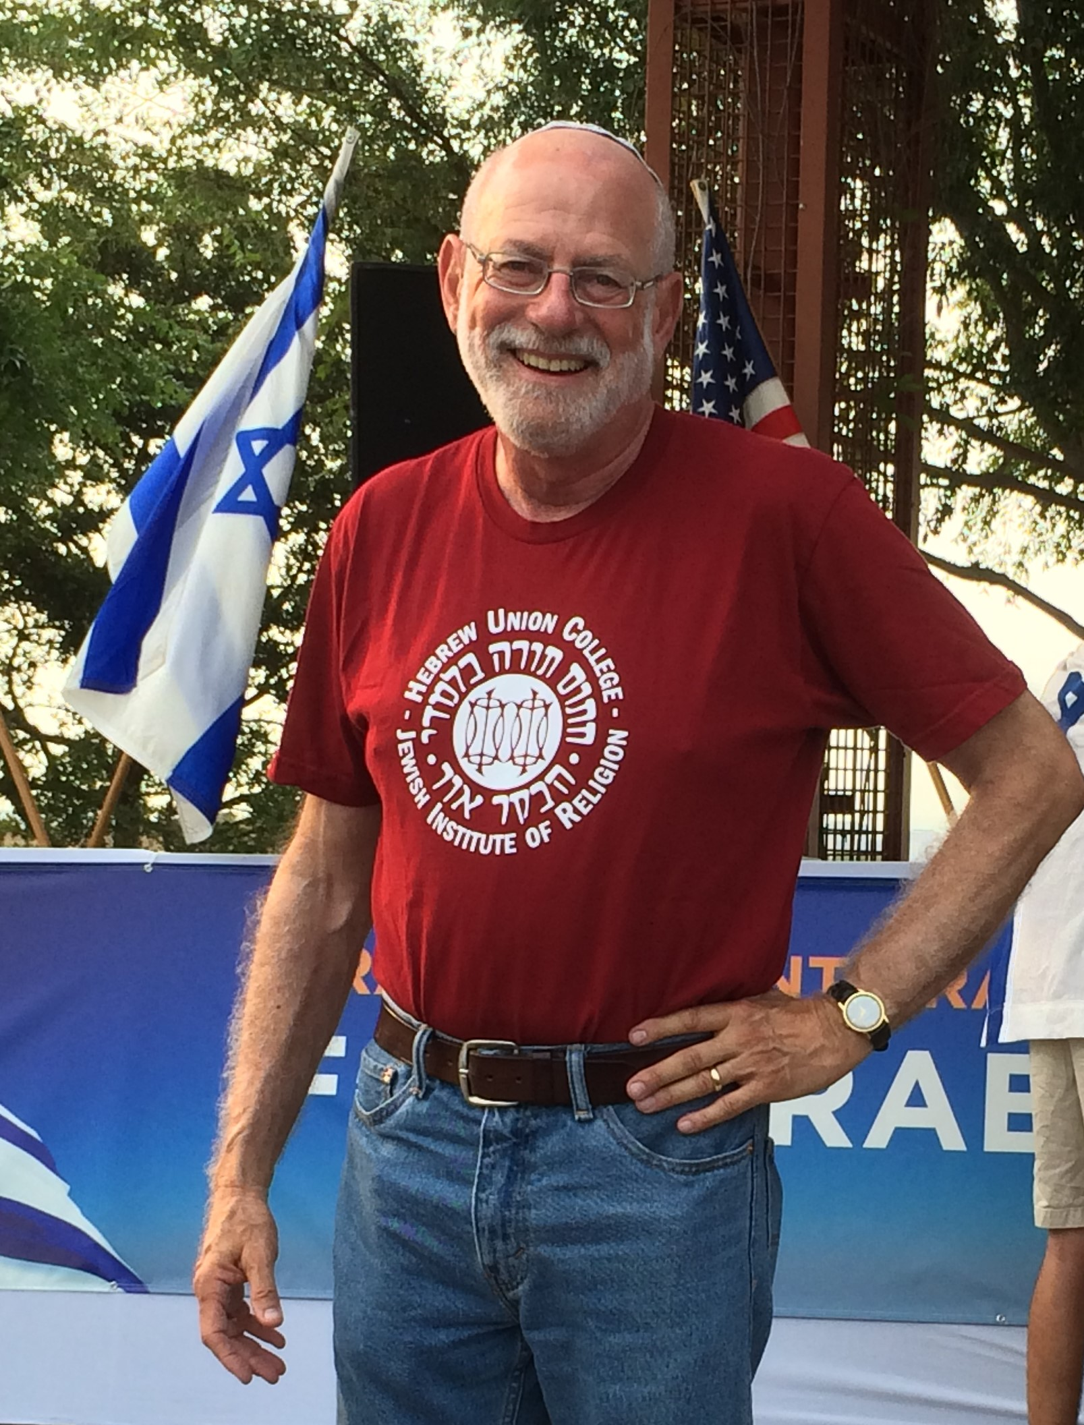
Steve
parent to myriads,
dearest friend
Love, Lydia & Ben

Slide 21
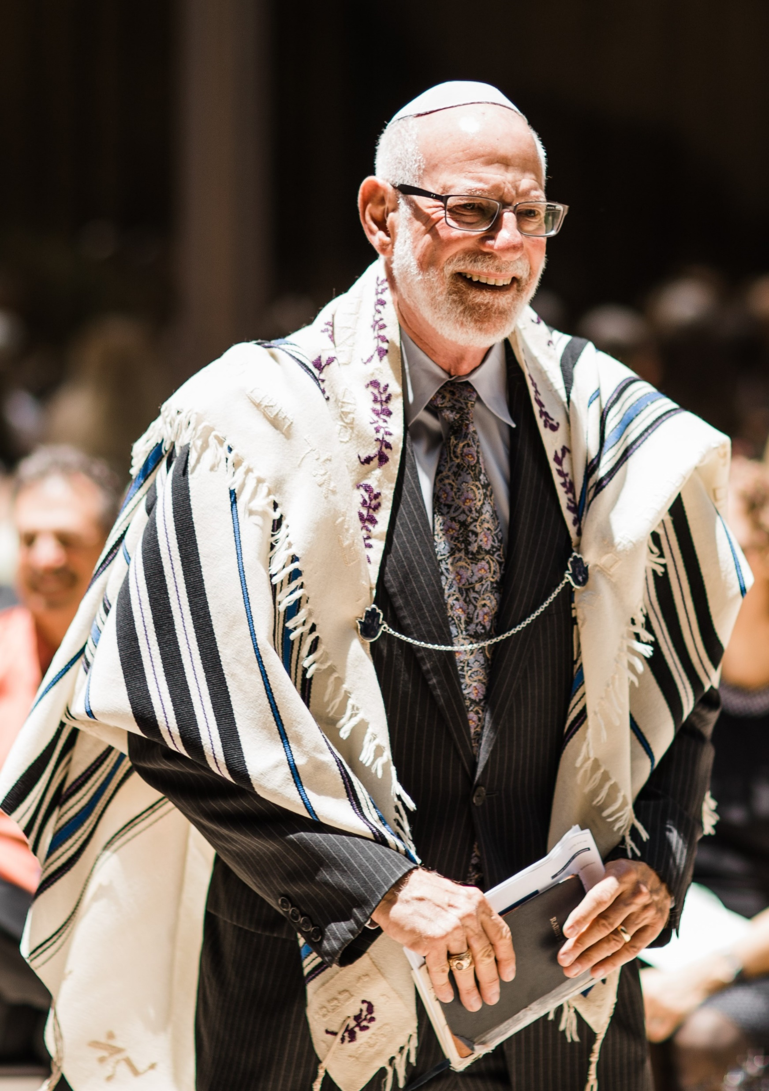
Mazel tov to my beloved Brother-in-Law
Like our patriarch Abraham, you model welcoming all with an open heart.
Love,
Honey

Slide 22
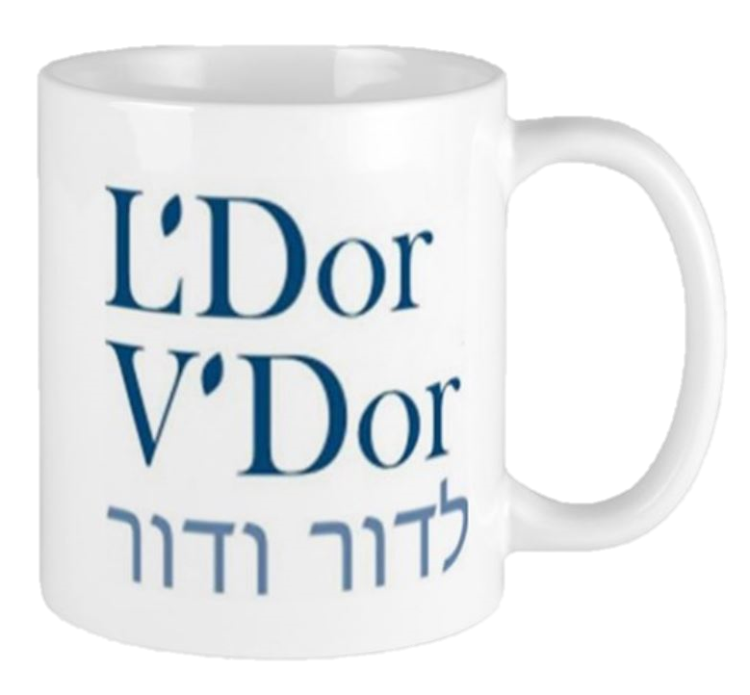
RAV EINSTEIN!
with admiration from the “Coffee Shop Rabbi”
Rabbi Ruth Adar

Slide 23
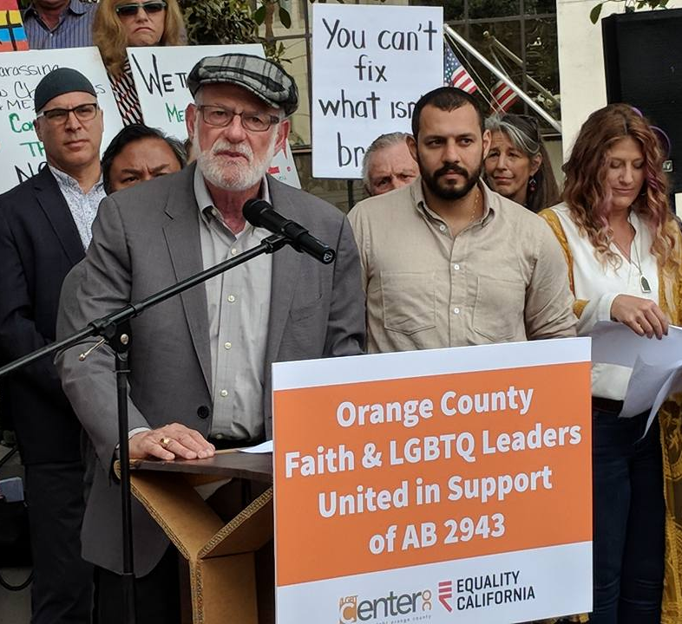
Rabbi Steve -
"He who walks with integrity and practices righteousness, speaks the truth from his heart."
(Psalm 15:2)
Rabbi Nico Socolovsky

Slide 24
We honor the
life-long work of Rabbi Stephen Einstein - a beacon of light in Orange County for justice activism, interfaith relations & kiruv.
Rabbi Stephen Einstein KOL HAKAVOD
for all you’ve done to bring holiness and meaning to the lives of others!
Rabbi Marcia Tilchin & the Collaborative Team
Rabbi Warren Levy

Slide 25
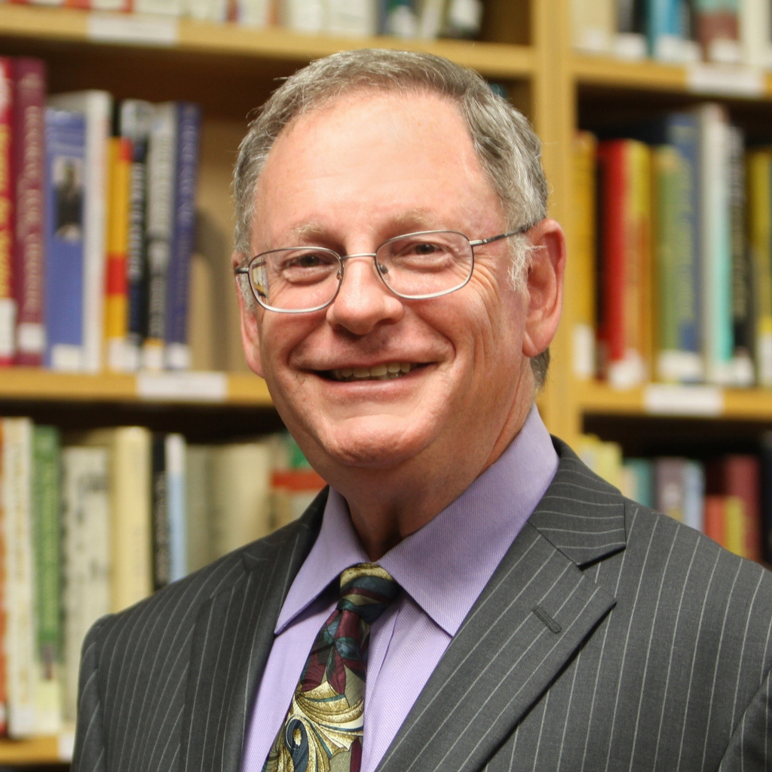
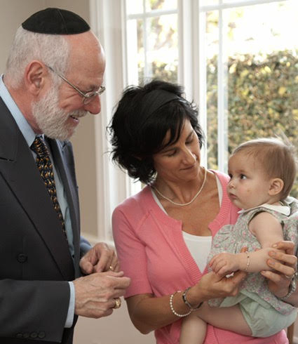
Stephen is an inspiration as my teacher, my colleague and my friend
Now it is our turn to say Mazel Tov to you, dearest Rabbi Einstein.
The Matusoff Family
Rabbi Mike and Sonia Lotker

Slide 26
Rabbi Steve Einstein Consummate Mensch and Trailblazer for Outreach
Rabbi Alan Henkin & Susana Castillo

Slide 27
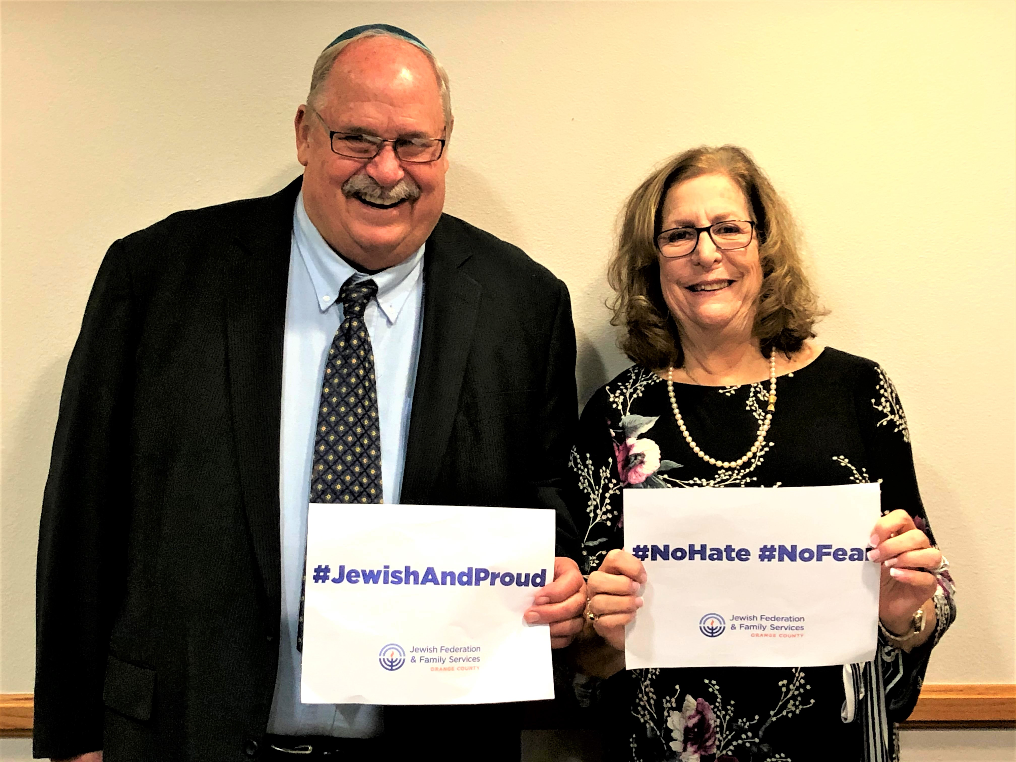
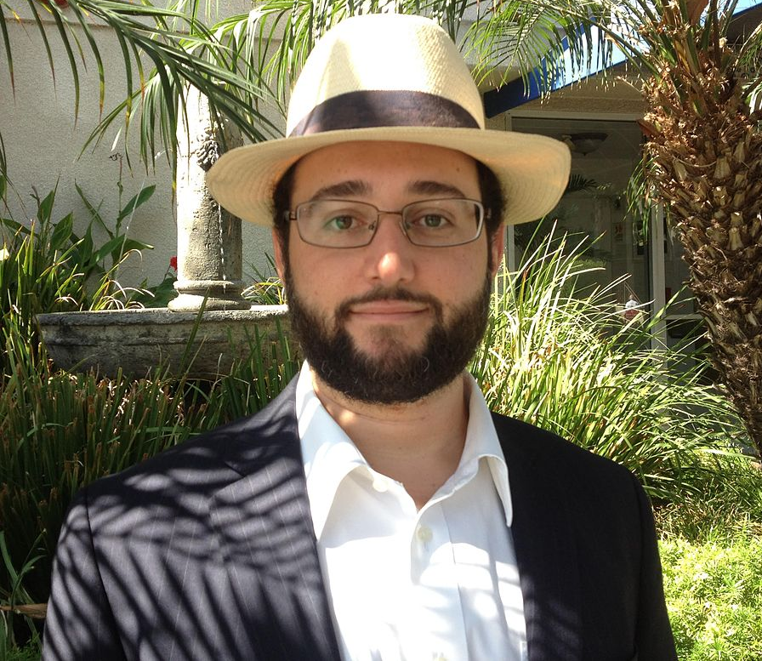
Congratulations to my teacher and friend,
Stephen Einstein!
Our Rabbi…Our Teacher…
Our Friend… Mazel Tov!
Rabbi Jason Rosner
Justin & Leslie Wheatley

Slide 28
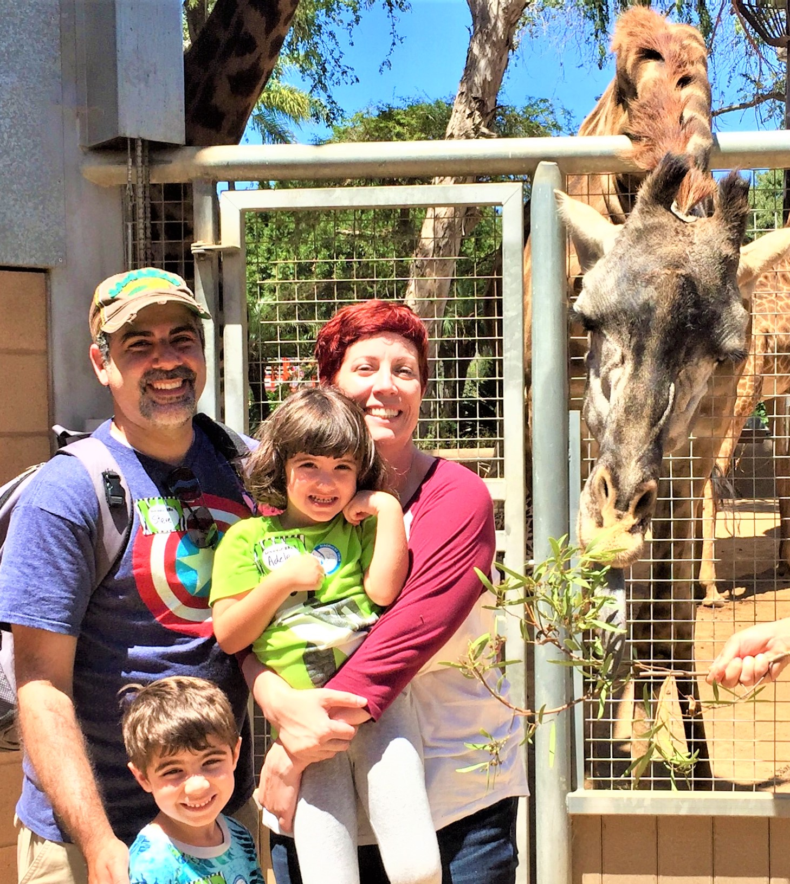

Slide 29
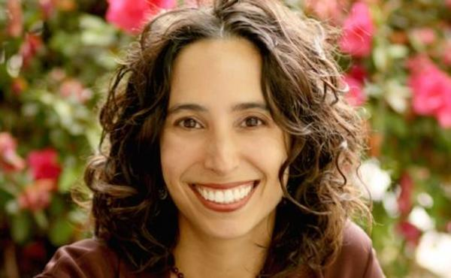
Thank you, Rabbi Steve. You are a gift & a gem!
Rabbi - You and Robin
are, and have been, a
gift to the Orange County Jewish community in many meaningful ways.
Rabbi Michelle Missaghieh
Temple Israel of Hollywood
S’gan Em Bet Din of SCCBD
Martin and Tamar Brower

Slide 30
Mazel Tov,
Uncle Steve!
We you!
Josh, Jessica and Amy, Sarah, Micah, Gabrielle and David
Cantor Natalie Young and Rabbi David N. Young

Slide 31
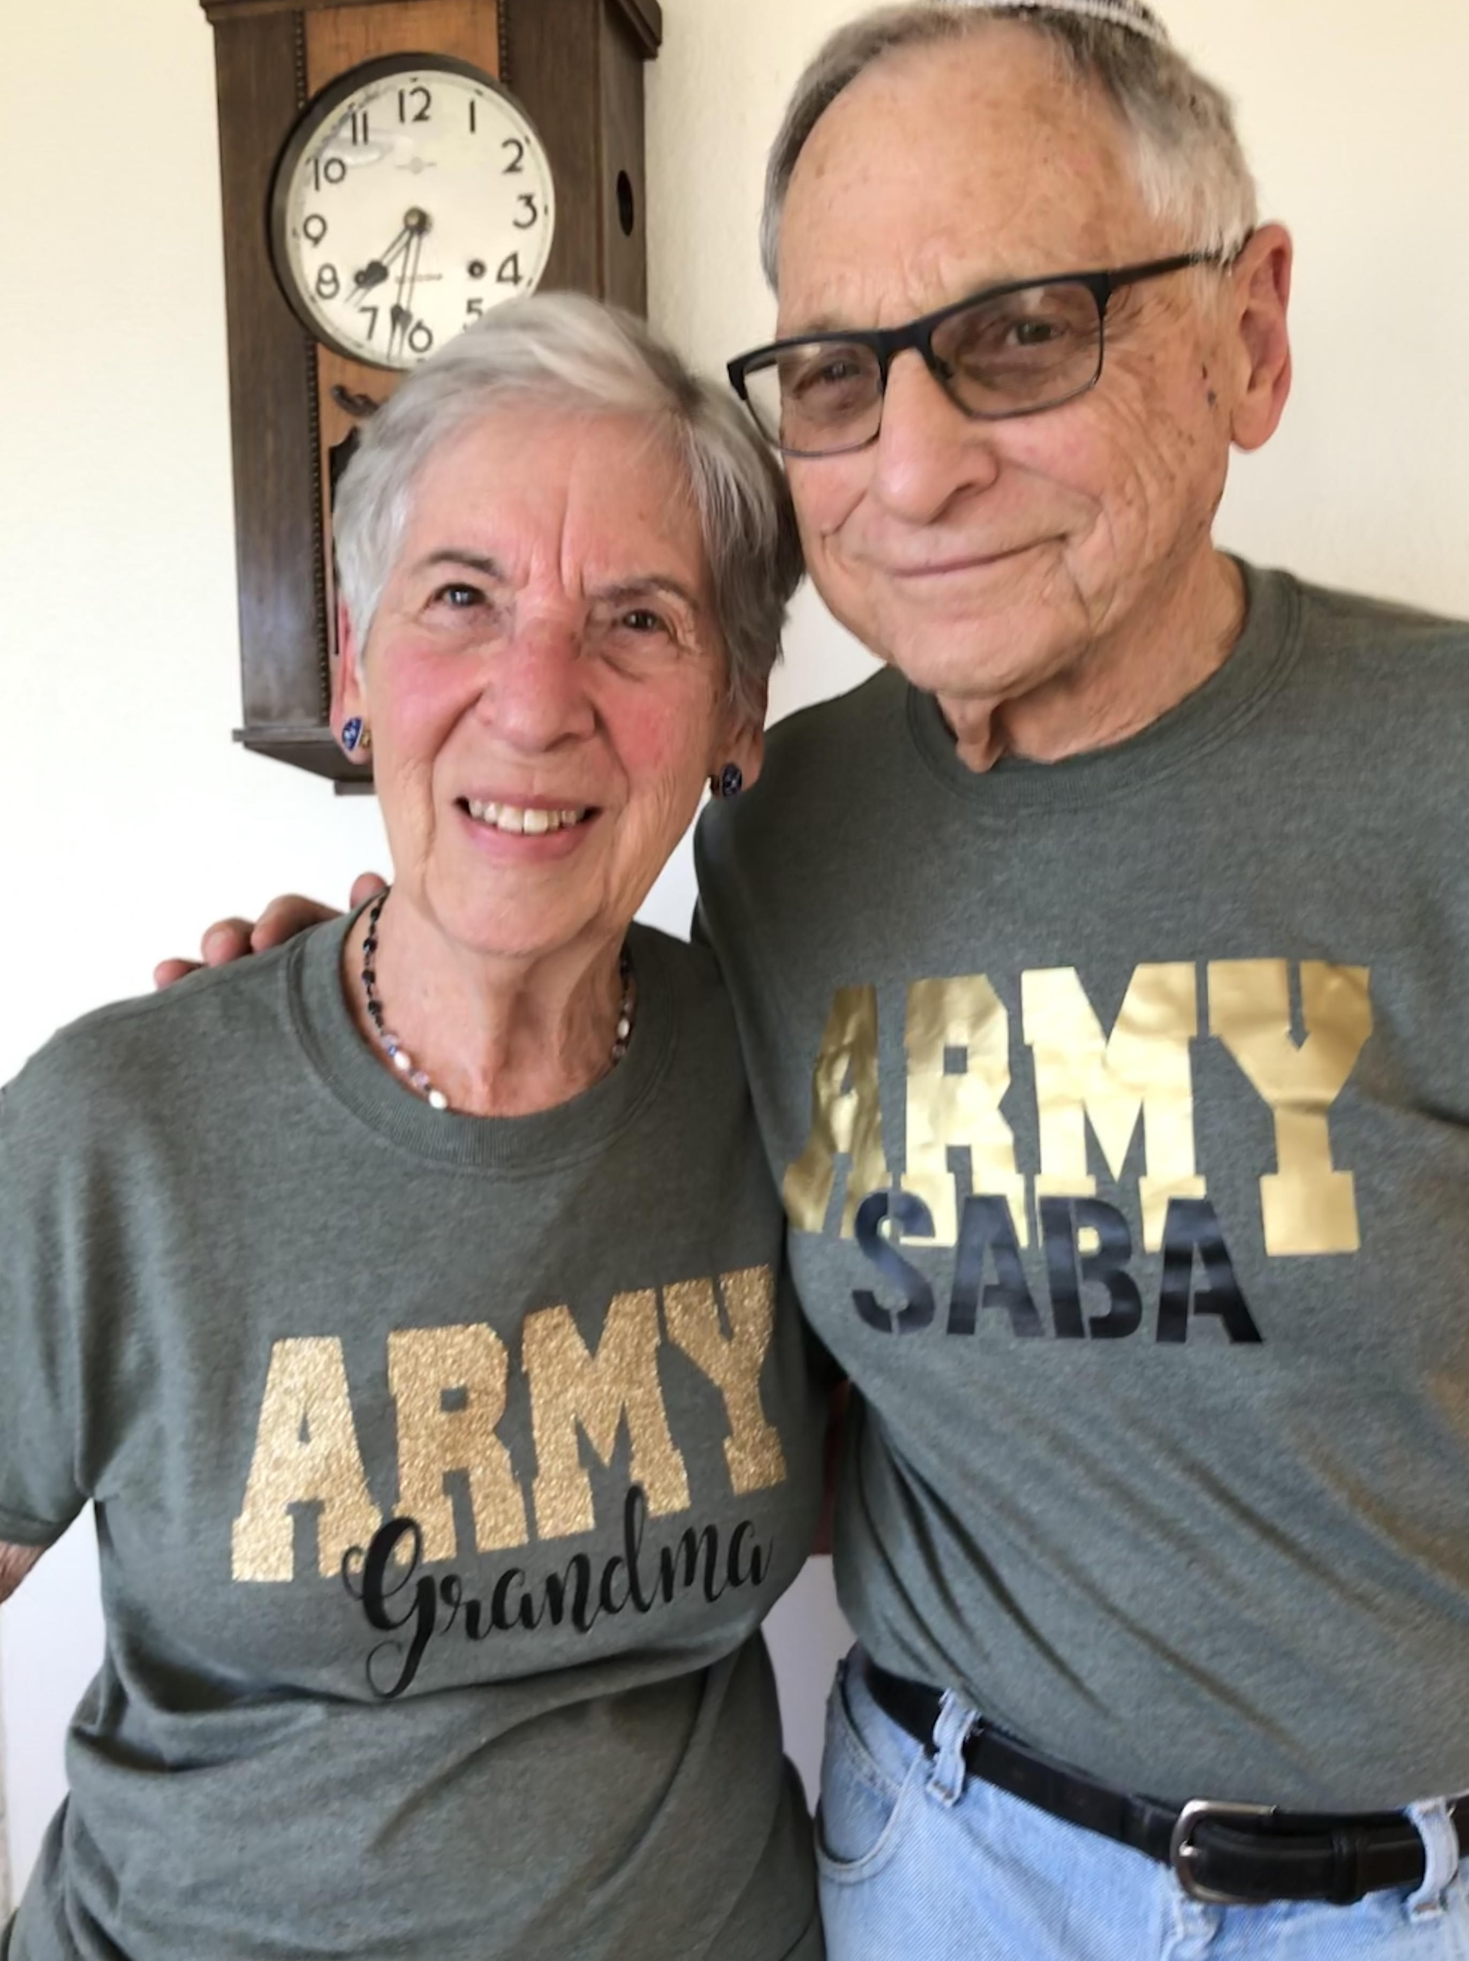
Stephen Einstein an outstanding Rabbi, Dayan & Leader
עֲשֵׂה לְךָ רַב, וּקְנֵה לְךָ חָבֵר
Find yourself a rabbi,
acquire a friend (Avot 1:6)
MAZEL TOV!
My Rabbi and Friend!
Rabbi Richard Steinberg
Frances & Rabbi Jerry Goldstein

Slide 32
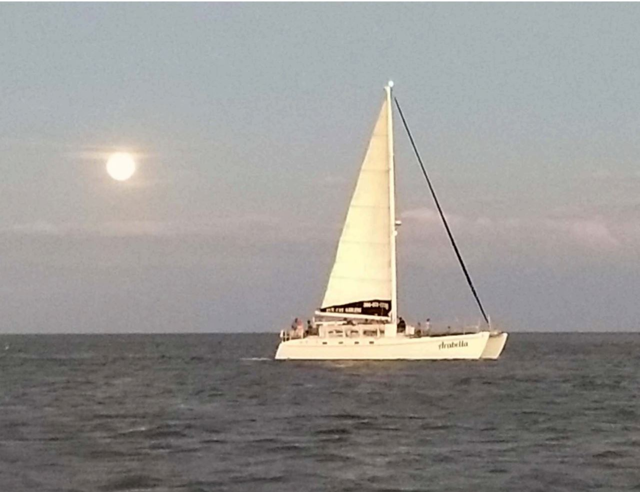
Dad/Zayde: You strengthen us in word and deed.
"You can't control the wind,
but you have always adjusted your sails."
Love, Gary & Gayle: Joshua, Sarah, Bella, Louisa; Hilary & David: Cohen, Simon; and Daniel
With enduring love, Heath, Diana, Levyn, Adielle & Asher

Slide 33
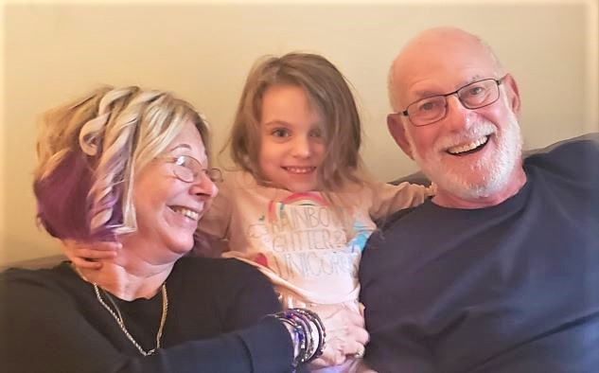
Dad –
We love you and are so proud of you!
Mazel Tov
from your friends and colleagues at
Joshua Holo Dean, Jack H. Skirball Campus
Rabbi Dvora Weisberg Director, HUC-JIR Rabbinical School
Cary Davidson Chair, W. Region Board of Advisors
Love, Zack, Jen & Ellery

Slide 34
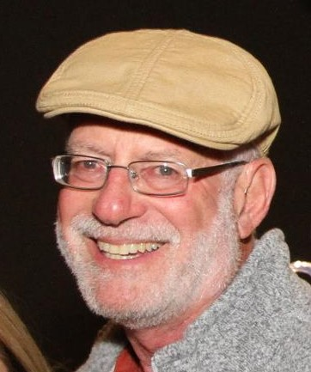
With deepest gratitude
for all the gifts you
bring to the world.
Kol ha kavod!
You are an inspiration.
Mazel Tov
Rabbi Laura Owens & Jack Bender
Rabbi Sara Goodman

Slide 35
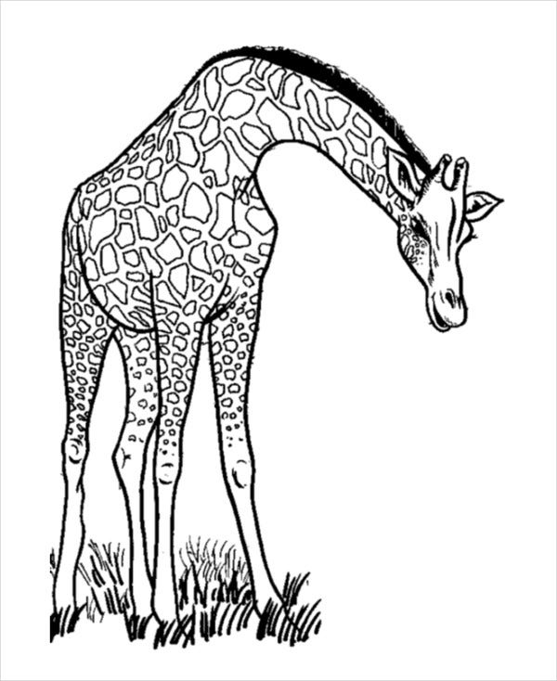
Rabbi Steve
A pathbreaking
role model of
welcome.
on your honor,
Steve.
Much gratitude,
Rabbi Lisa Edwards
Dan Bridge

Slide 36
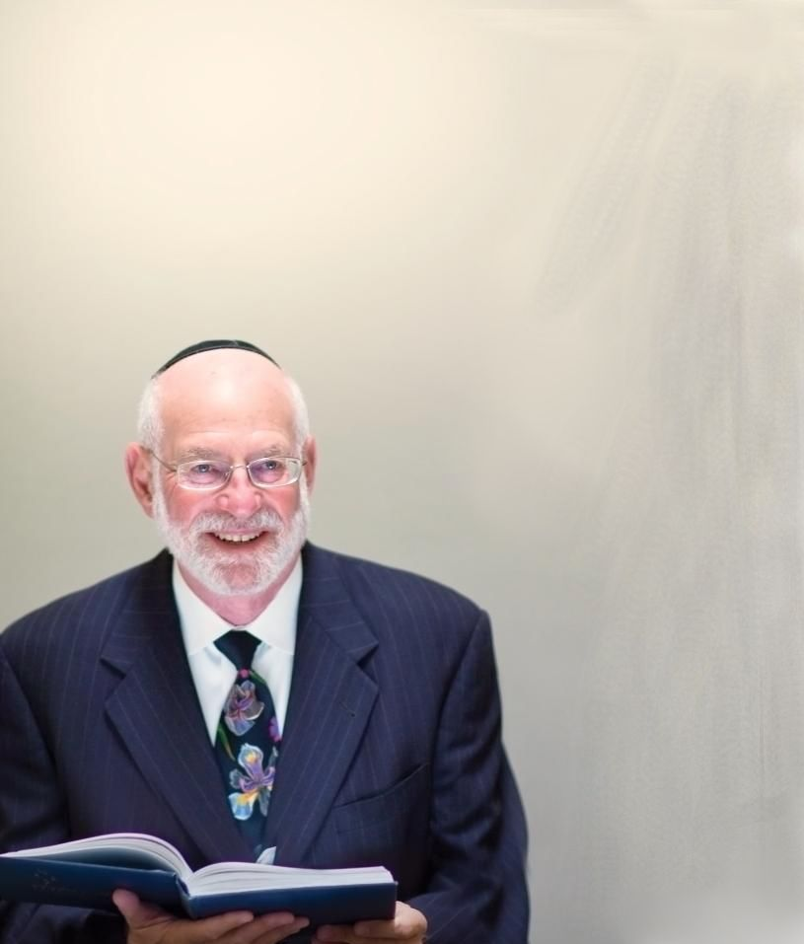
Dad – Your dedication continues to be an inspiration.
Ben Zoma taught: Who is honored? The one who honors others.
Mazel tov to Rabbi Einstein for offering love and honor to all humanity.
Love, Jennifer and Ruben
Rabbi Arnold Rachlis & Cantor Ruti Braier

Slide 37
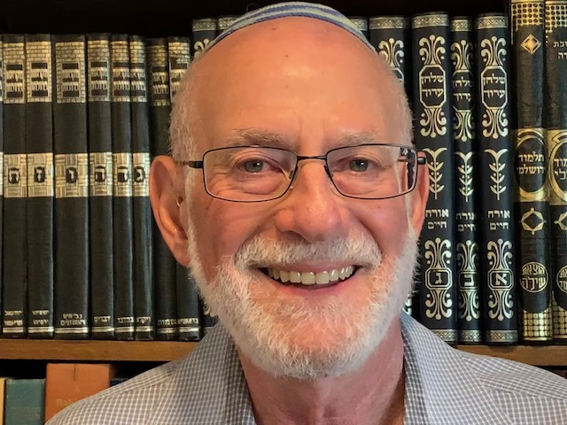
Rabbi & Friend
Inspiring the rabbinates
of so many colleagues
Todah M’rosh,
Rabbi Lisa Hochberg-Miller
With much love,
Rabbi Larry & Carol Goldmark

Slide 38
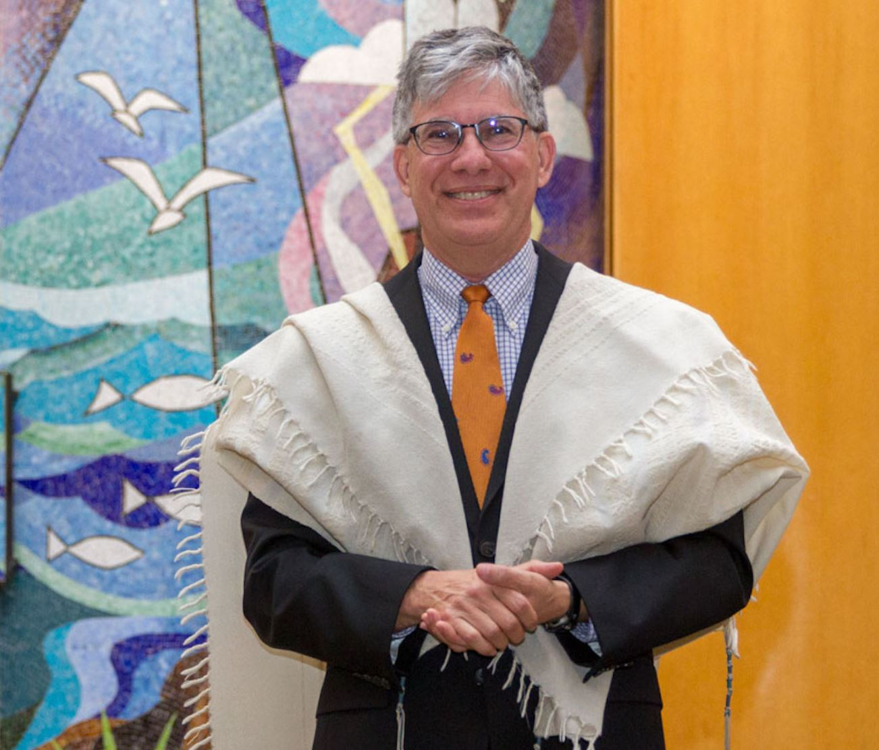
To Rabbi Steve
Kol Hakavod. May you continue to teach us what is just!
With Gratitude
for your friendship
and mentorship.
Rosalee Lubell
Rabbi Elie Spitz

Slide 39
We congratulate our Friend and Colleague,
Rabbi Stephen Einstein!
Rabbi Rachel Adler, Los Angeles CA
Helen Atkinson, Fullerton CA
Jerome Becker, Cambria CA
Irene Borses, Fountain Valley CA
Andrew Breshears, Ventura CA
Rabbi Aryeh Cohen, Los Angeles CA
Rabbi Hillel Cohn, San Bernardino CA
Rabbi Corinne Copnick, Sherwood Forest CA
Rabbi Sarah DePaolo, Irvine CA
Rabbi Shelton Donnell, Portland OR
Gayle Douglas, Fountain Valley CA
Rona & Scott Elias, North Venice FL
Bernard Fainsztein, Fountain Valley CA
Jessica Gardner, Philadelphia PA

Slide 40
“Together may we grow
from strength to strength.”
“Together may we grow from strength to strength.”
Susan Gelerter, Folsom CA
The Gilbert Family, California & Nebraska
Dan, Sarah, Micah & Noemi Gilbert, Omaha NE
Sandi Goldstein & Richard Norene, Seal Beach CA
Shepard Lowell & Aliza Goldstein, Tustin CA
Sharon Haber, Huntington Beach CA
Michael Haber, Huntington Beach CA
Jill Housen, Claremont CA
Rabbi Susan Laemmle, Los Angeles CA
Rose & Steven Lesser, Newport Beach CA
Rabbi Leah Lewis, Redondo Beach CA
Rabbi Stuart & Wiebke Light, Irvine CA
Rabbi Cantor Osnat Margalith, Los Angeles CA
Rabbi Myrna Matsa, Los Angeles CA
Marcia McReynolds, Fountain Valley CA
Rabbi Janice Mehring, Atascadero CA

Slide 41
Rabbi Nancy Myers, Westminster CA
Steven Poretzky, Encino CA
Rabbi Eva Robbins, Los Angeles CA
Rabbi Rick Schecter, Glendale CA
Rabbi Arinna Shelby, Redondo Beach CA
Dr. Andrew & Julie Shpall, Calabasas CA
Rabbi Suzanne Singer, Riverside CA
Jeffrey Stolrow, Newport Beach CA
Rabbi Karen Strok, Sherman Oaks CA
Harris & Eileen Stutman, Seattle WA
Rabbi K’vod Wieder, Aliso Viejo CA
Sheila & Jay Witzling, Irvine CA
With gratitude and admiration, we honor Rabbi Stephen Einstein!

Slide 42
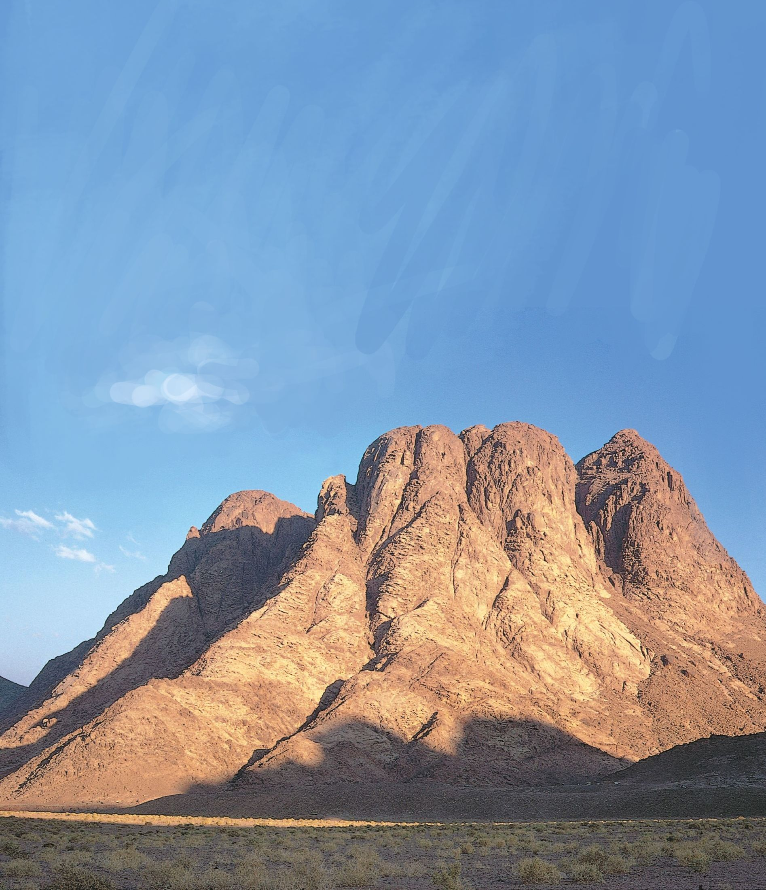
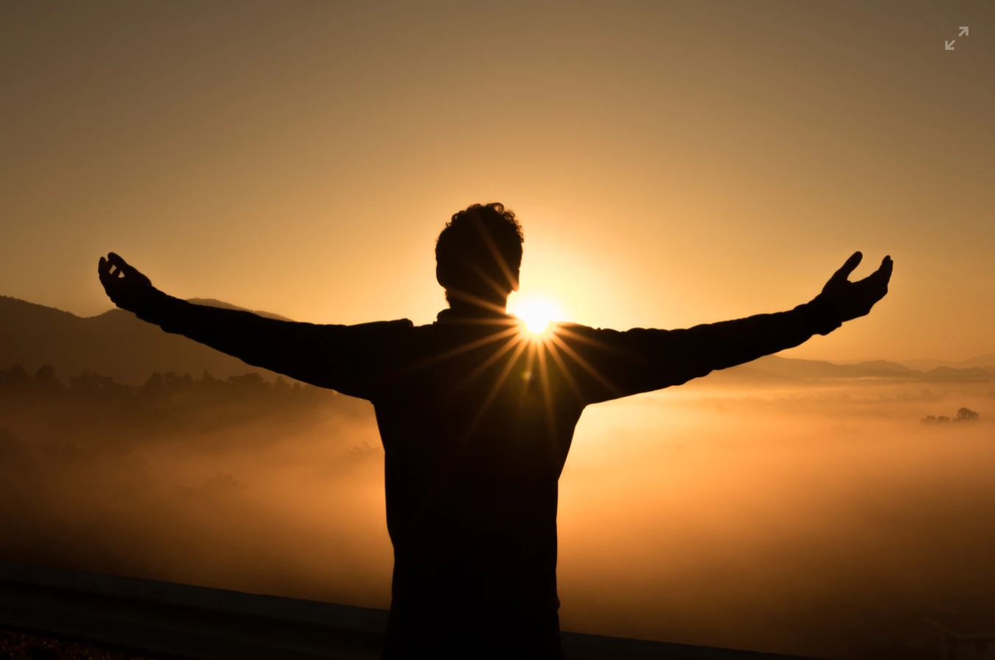
BLESSINGS
for the next
50!
Thank you!
for your leadership
and wisdom.
Dan Shevitz
Rabbi Jonathan Bernhard

